Slide 1
ABLEISM IN MEDIA: Books for children
Created by Dr. Maya Kalyanpur
as part of the Leaders for Inclusion Project
at the University of San Diego
and generously funded by the Johnson Family Foundation
August 2019
Notes:
This presentation focuses on one aspect of ableism, portrayals of people with disabilities in media, looking particularly at children’s literature.
It identifies the embedded stereotypes that often occur in depictions of characters in fiction, and presents a set of guidelines adapted from Nasatir & Horn (2003) for teachers to use to evaluate children’s literature when choosing books for their classrooms.

Slide 2
Outline
You will be introduced to the predominant ableist stereotypes in media and children’s literature
You will apply the given guidelines to evaluate the portrayal of people/ children with disabilities as a central character to select a suitable children’s book
You will create a lesson plan/ unit around the book you have selected.

Slide 3
Alignment with DSE Tenets
The objectives of this module are to:
Contextualize disability within the social sphere by highlighting deficit model attitudes towards people with disabilities, a form of ableism, often depicted in media.
Promote social justice by challenging common stereotypes
Present overt and subtle examples of negative and positive portrayals of people with disabilities in children’s literature

Slide 4
Ableism
Ableism can be defined as discriminatory societal attitudes towards people with disabilities, similar to racism, sexism, or ageism, etc. It does not deny the presence of a disability, such as physical, behavioral or intellectual limitations, but recognizes that negative attitudes and stereotypes impose additional limitations that further handicap individuals with disabilities.
Ableism occurs when dominant beliefs exclude the experiences of people with disabilities or use stereotypical representations. Ableism places the responsibility for discrimination on the able-bodied.
Source for ableism: Haller (2010). Representing disability in an ableist world: Essays on mass media. Louisville KY: Advocado Press.
Notes:
Just like other forms of discrimination against age, race and gender, ableism discriminates against people with disabilities.
Negative attitudes and stereotypes increase barriers for people with disabilities.
Most importantly, we recognize that ableism places the responsibility for discrimination on the able-bodied and the need for change that must come from mainstream society. This definition of ableism is from Beth Haller’s book (2010) of essays on ableism in media.

Slide 5
Manifestations of Ableism
Assumptions (belief that people with disabilities want a cure)
The media (newspapers, books, movies, tv, etc.)
The language of disability
Physical barriers (buildings don’t have ramps, elevators, Braille, etc.)
Transportation (No elevators, limited routes, etc.)
Service delivery (segregated or special school systems).
The Eugenics Movement (Structural practices of ‘Improving the human race’)
Notes:
Ableism manifests in many ways.
We see it in the assumptions that able-bodied people have such as assuming people with disabilities want a cure, or are not able to live independently.
We see it in media, in the language that newspapers and TV series to describe people with disabilities. For instance, a person might be described as “the autistic” or being “confined to a wheelchair” or “suffering from cerebral palsy”.
We see it in physical barriers, when buildings don’t have elevators or ramps, or the “handicapped entrance” is at the back of the building, or signs don’t have Braille on them.
We see it in transportation when there is no elevator to access the subway station, limited accessible routes, or confusing signage that is not clear to navigate.
We see it in segregated service delivery systems, when children with disabilities are placed in special schools or have to travel in special buses. A good resource for more information on the limitations of segregated or special school systems, you may want to read Jonathan Mooney’s (2008) book, “The Short Bus”.
And lastly, we also see it during the 1900s when the Eugenics Movement believed that it was a necessity to eliminate or prevent further birth of people with disabilities to ensure civilization and purity.
In this presentation, we will focus on the media aspect and especially on children’s literature.

Slide 6
Ableist Stereotypes
Pitiable and pathetic
Bitter/own worst enemy
“Atmosphere”
Sinister and/or evil (villain)
Laughable
Burden
Asexual
Incapable of participating in everyday life
“Supercrip”
Notes:
This slide lists the ableist stereotypes that are most commonly found in literature. In the next few slides, we will explain each stereotype and provide famous or well-known examples from media.
This list is compiled from research originally conducted by Douglas Biklen and Robert Bogdan in 1977. Although over the years, there has been increasing awareness about depictions of these stereotypes, so they may not be as common and certainly not as overt as they were in the 1970s.
However, as more recent research shows, these stereotypes still exist in subtle forms.
This research is included in the resources at the end of the presentation.
Participants are encouraged to think about additional examples for each of these stereotypes as we go through this list.

Slide 7
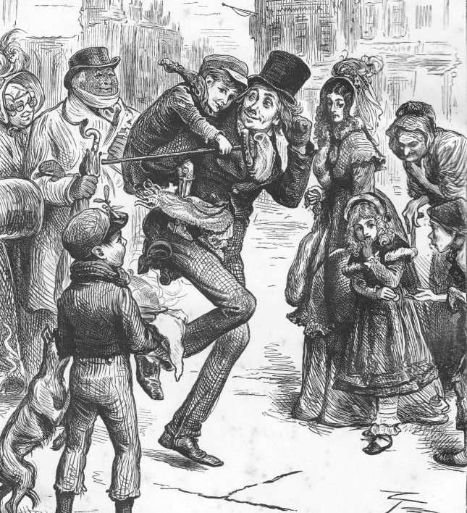
Pitiable and Pathetic
Tiny Tim in
“A Christmas Carol”
A Christmas Carol by Fred Barnard. PD-US-Art
Notes:
This stereotype relates to the image of a person with a disability as being pitiable and unfortunate.
Tiny Tim, a character in Charles Dickens’ famous novel, “A Christmas Carol” is described as “poor” Tiny Tim. Although all of the members of his family are poor, there is a special level of pathos reserved for the little boy because he uses crutches.
Other examples include Clara in Johanna Spyri’s “Heidi” and Colin Craven in Frances Hodgson Burnett’s “The Secret Garden”.
Although these books might lead us to believe that this stereotype is “old”, the idea of the “poor cripple” still persists.
Movies like “Me Before You” and “The Upside” convey the notion that life as a person with a mobility impairment is not worth living. , and give able-bodied people reason to feel a sense of “there, but for the grace of God, go I”.
We see more of this in the next stereotype.

Slide 8
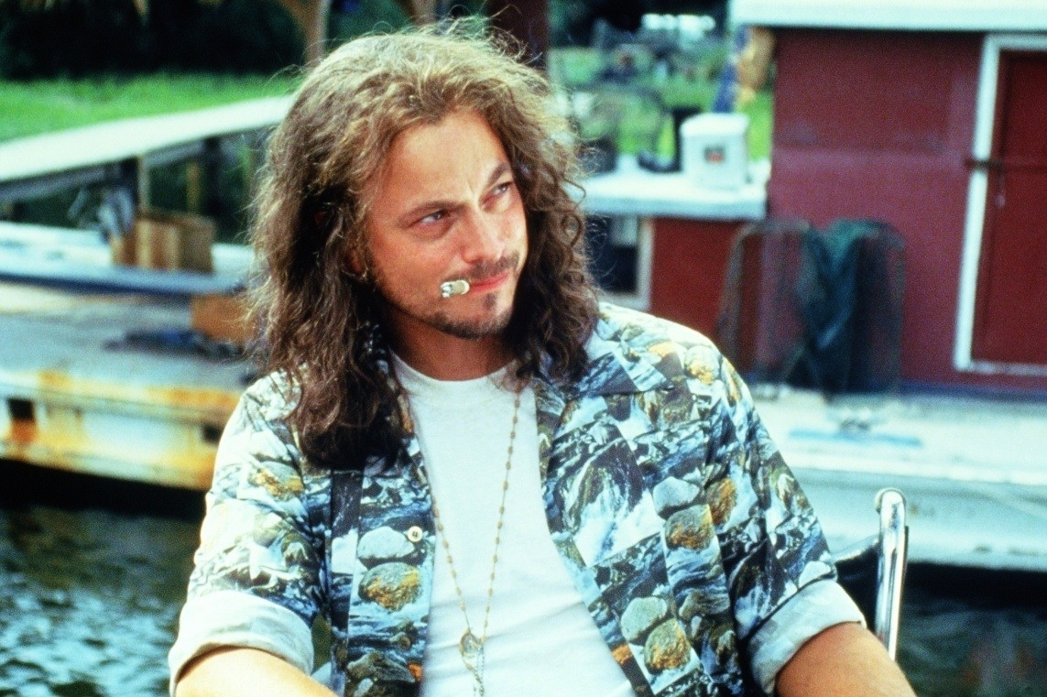
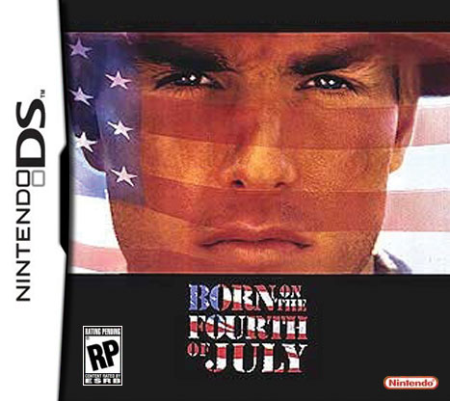
Bitter/Own Worst Enemy
Ron Kovic (Tom Cruise) in
“Born on the Fourth of July”
Lieutenant Dan in “Forrest Gump”
That terrible time when we forgot our warriors... by Greg Bishop. CC BY-NC-SA 2.0
DS Born on the Fourth of July by Good Fynes. CC BY-ND 2.0
Notes:
Here the character is depicted as bitter and therefore their own worst enemy.
Even though “Born on the Fourth of July” is based on the true story of Vietnam veteran Ron Kovic, the movie focuses on his unhappiness when he returns from the war, and his family’s helplessness in the face of his anger and bitterness.
Similarly, in “Forrest Gump”, Lt. Dan is also angry and bitter when he returns from the war.
Although many people with acquired disabilities (perhaps as a result of an accident or through combat) may have a longer period of adjustment than people who were born with their disability, the negative message that is conveyed here is that the life of a person with a disability is not worth living at all.
Further, by becoming bitter, and “choosing” to withdraw from society because of the negative emotions that might accompany these changes in life due to the acquired disability, they become their own worst enemy – society cannot help them because they don’t want to be helped!
This circular argument places the blame squarely on the victim.

Slide 9
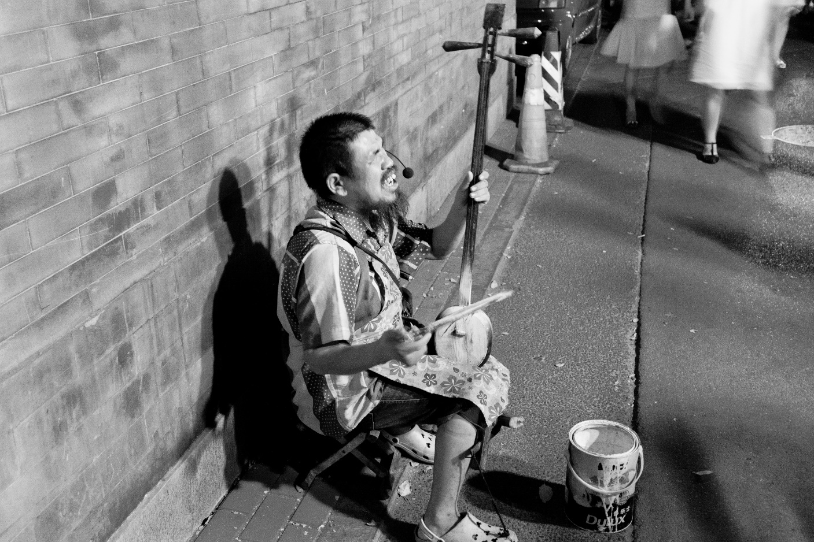
“Atmosphere”
Blind Musician
“Murphy Brown” original version
Blind street musician playing by Nikolaj Potanin. CC BY-SA 2.0
Notes:
Secondary characters may often be attributed a disability for the sake of atmosphere, where the disability often has little to do with the plot or narrative, and merely adds a stereotypic yet ‘diverse” representation of the character.
Examples might include blind street musicians.
In the original, late 1980s version of the TV series, “Murphy Brown”, which was set in a liberal-thinking, politically correct workplace environment, a secondary character in a wheelchair often crossed the set in the background. This character had no other role to play other than this, and never spoke a line. Their only “role” was to represent the tokenism of a diverse workplace.

Slide 10
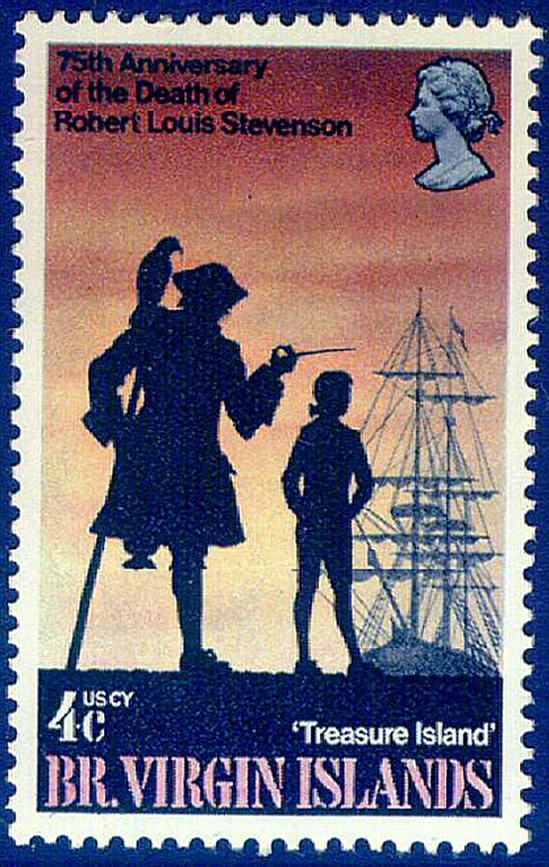
Sinister and/or Evil (Villain)
Long John Silver in “Treasure Island”
Captain Hook in “Peter Pan”
Treasure Island stamps by Jennifer Toombs. In the public domain.
Captain Hook by Christopher Brown. CC BY 2.0
Notes:
The stereotype of people with disabilities as villains, sinister and evil, is the most longstanding one in fiction.
Some examples include
Long John Silver, the “peg-legged” pirate in Robert Louis Stevenson’s “ Treasure Island”
Captain Hook in James Barrie’s “Peter Pan” who had lost his left hand and used a hook instead.
More recently, in “The Lion King”, the villain is called (and has a) “Scar”.

Slide 11
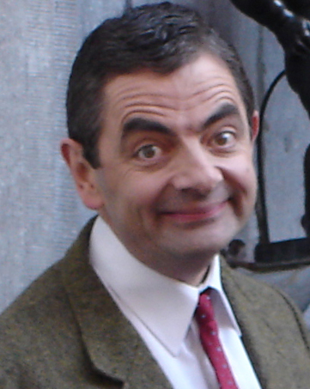
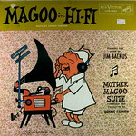
Laughable
Rowan Atkinson by Antonio Zugaldia. CC0.
Dumbo
Bobby Boucher (Adam Sandler) in “The Waterboy”
Mr. Bean
Mr. Magoo
Mr. Magoo in Hi-Fi by Kevin Dooley. CC BY 2.0
Notes:
The stereotype allows us to laugh at people with disabilities.
People laugh at Dumbo’s big ears until he finds that he can fly because they are so big.
Mr. Magoo’s severe myopia makes him an object of ridicule.
Jerry Lewis’ characters, similar to Adam Sandler’s character in “The Waterboy” and Rowan Atkinson’s “Mr. Bean” all portray people who appear to be stupid and therefore laughable.

Slide 12
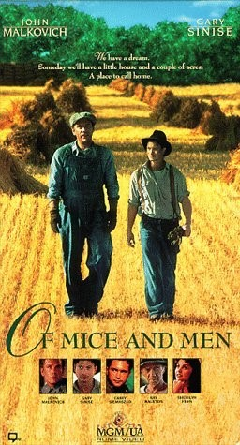
Burden
Lennie Small in
“Of Mice and Men”
Of Mice and Men mgm-us vhs front by Jesper Wiking. CC BY-ND 2.0
Notes:
A person with a disability is often assumed to be a burden on society and their family.
This stereotype was depicted in Lennie Small’s character in John Steinbeck’s famous novel “Of Mice and Men”, as well as by the titular character in “What’s Eating Gilbert Grape?”

Slide 13
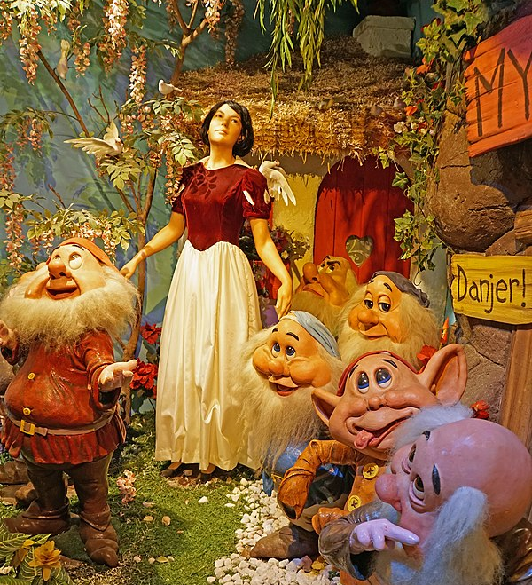
Asexual
The dwarfs in “Snow White and the Seven Dwarfs”
Snow White and the Seven Dwarfs by Dennis Jarvis. CC0
Notes:
The question that arises from the embedded stereotype in the Snow White story is:
Would we be comfortable about Snow White sharing a cottage with seven men if they hadn’t been little people?
Because of the stereotype that little people (and most people with disabilities) are asexual and child-like, it seems to become quite okay.
The obverse side of this stereotype is of being over-sexed to the point of violence and is often conflated with the stereotype of being villainous and evil.

Slide 14
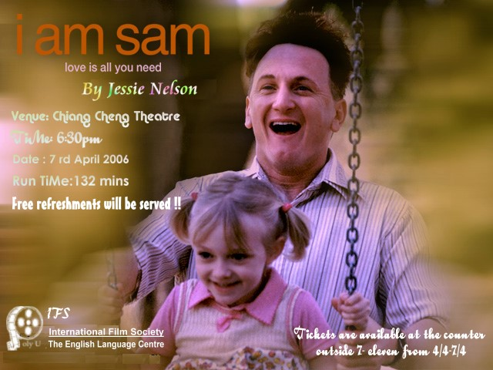
Incapable of Participating in Everyday Life
Sam Dawson (Sean Penn)
in “I am Sam”
I Am Sam Leaflet. by Adam@ecadamf. CC BY 2.0
Notes:
This stereotype is similar to the previous one of asexuality, where it is assumed that people with disabilities are incapable of participating in everyday life or becoming adult and productive citizens, and are child-like.
In “I am Sam”, Sam who has a developmental disability is deemed unfit to bring up his young daughter and has to fight the legal system to claim his right as a parent to raise her.

Slide 15
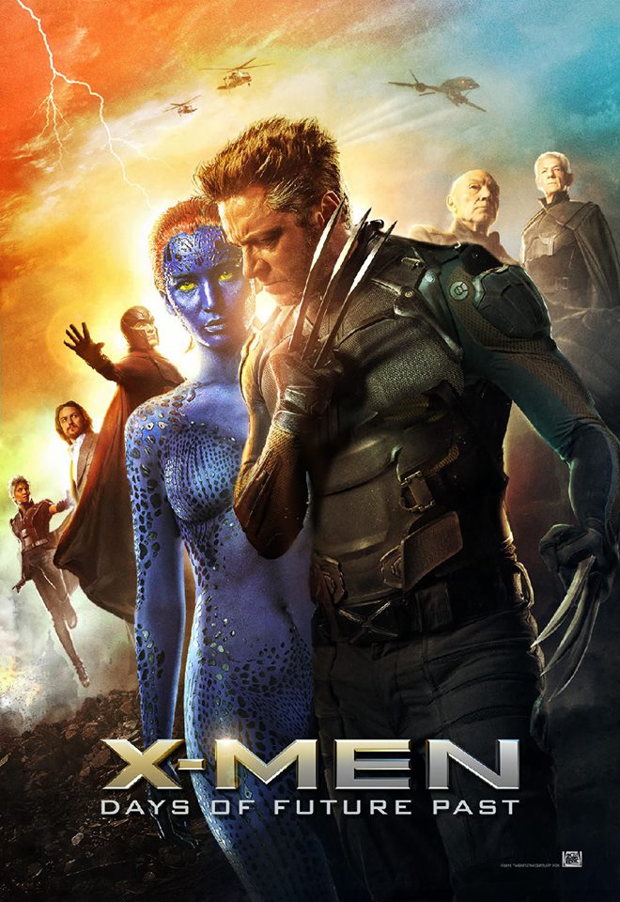
“Supercrip”
Raymond in “Rain Man”
Individuals who had an X gene (that other humans didn’t have) and it provided them with special powers
X-Men: Days of Future Past by Global Panorama. CC BY-SA 2.0
Notes:
In some ways, the obverse of the incapable stereotype is this belief of the “supercrip”, that some people with disabilities have special skills.
For instance, Raymond in “Rain Man”, who makes his brother rich by counting cards in a casino in Las Vegas, but ends up back in the institution himself because he is assumed to be incapable of participating in everyday life.
One aspect of this stereotype is the belief that the person has somehow “overcome” their disability, and in a form of “inspiration porn”, we are struck with wonder at what the person has accomplished, even if it may not be something so extraordinary by typical standards. Many of us are amazed that blind people have “overcome” their disability to be able to ski, for instance, when in truth, all was needed was to find a way to work around one’s disability by, say, offering tandem skiing, not overcome it!
View video with group: http://www.youtube.com/watch?v=vqbXPfaN_VM

Slide 16
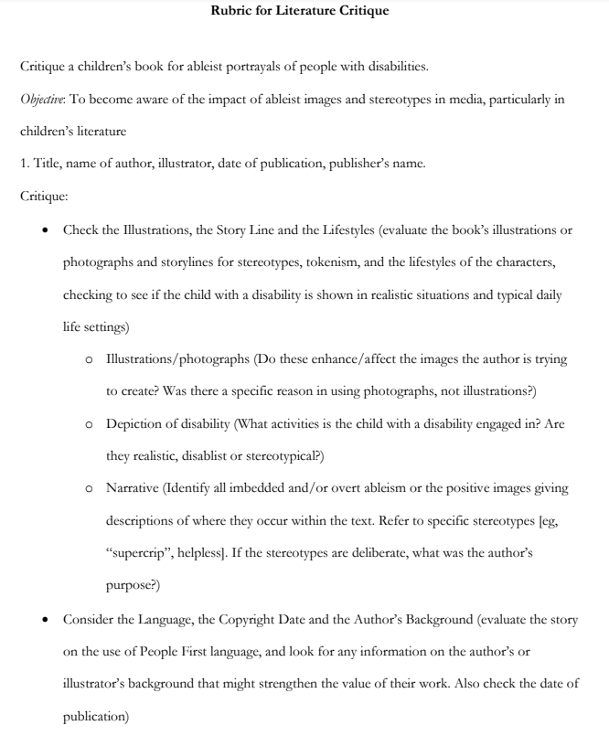
Activity # 1:
Let’s critique a book, using the guidelines on the hand-out given. (Guidelines are adapted from Myers & Bersani (2009), and Nasatir & Horne (2003) articles.)
Notes:
The guidelines adapted from Nasatir & Horne’s (2003) article provide a framework for evaluating children’s picture books depicting a central character with a disability for use in the classroom.
I usually choose the book, “Nick Joins In” by Joe Lasker which was written in 1980, just after PL 94-142, the first law mandating the provision of an appropriate education for children with disabilities, now known as the Individuals with Disabilities Education Act or IDEA.
The book has both overt and covert stereotypes and can lead to a good discussion about what is a good choice of book.
It provides a historical context that situates the story in a time when children with physical disabilities were included in regular classrooms but had to travel in special buses. At first, Nick’s only friend is Timmy, who has learning disabilities himself. By the end of the book, Nick has been “accepted”, but only because he saves the day and becomes a “superhero” by solving a problem for his classmates.

Slide 17
Select a book and critique it, using the same guidelines
ACTIVITY # 2:
Notes:
[INSTRUCTIONS - for this exercise – which can be done individually or in small groups, ask the participants or small groups to choose a book from the list provided in the supplementary materials]
[INSTRUCTIONS – Once the book is selected, mention they have 30 minutes to read the book, and then use the guidelines to evaluate the materials.]
Please note, while this activity and these books focus only on elementary age children’s picture books, the guidelines can be used for books of fiction for all ages.

Slide 18
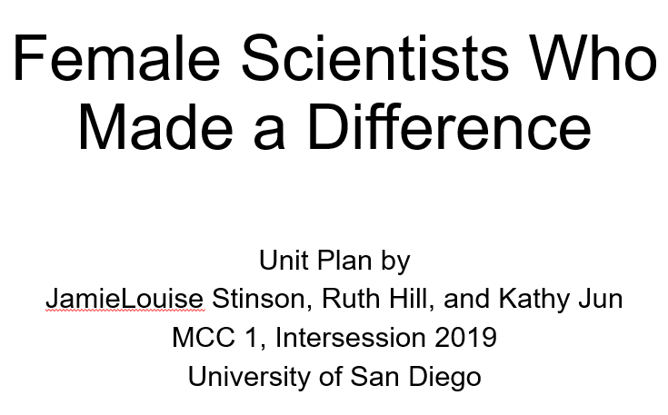
Optional Activity # 3:
Develop a lesson plan/ unit around the book.
Notes:
[INSTRUCTIONS – If there is sufficient time - after participants have evaluated the book and decided whether they would recommend/use it or not. Instruct the participants to develop a lesson plan and integrate the book into it. If they do not recommend it, they can develop a lesson plan which intentionally aims to increase awareness about media stereotypes and negative portrayals.]
[INSTRUCTIONS – Mention they have XX minutes to develop a lesson plan/unit around the book.]
In the example shown, JamieLouise Stinson, Ruth Hill and Kathy Jun, students at the University of San Diego, used the book by Julia Finley Mosca, titled “The Girl who Thought in Pictures” about Temple Grandin, a professor of animal sciences who has autism, in a unit about female scientists. They also included books featuring women of color to depict other aspects of diversity as well.

Slide 19
Additional Resources
Disability Bias in Children’s Literature
Disability in Children's Literature: A Website to Learn about the Portrayal of Disabilities through Different Mediums
Dyches, T. T. & Prater, M. A (2000). Developmental disability in children’s literature: Issues and annotated bibliography. Council for Exceptional Children, Arlington, VA. Div. on Mental Retardation and Developmental Disabilities.
Hughes, C. (2012). Seeing blindness in children's picture books. Journal of Literary and Cultural Disability Studies. 6(1), 35-51.
Holt, K. (2019). The complicated politics of disability: Reading “The Little House” books and Helen Keller. In M.A. Green-Barteet & A.K. Phillips (Eds.) Reconsidering Laura Ingalls Wilder: Little house and beyond, pp. 32-48. Jackson: University Press of Mississippi.

Slide 20
Additional Resources (cont.)
Myers, C. & Bersani, H.(2009) Quick Ways to Analyze Children’s Books for Ableism: Prejudice by Able-bodied and Ableminded People, Rethinking Schools, 23 (2), 52-54.
Rubin, E. & Strauss Watson, E. (1987). Disability Bias in Children’s Literature. The Lion and the Unicorn, 11(1), pp. 60-67.
Turner, N. D. I., & Traxler, M. A. D. (2000). Children's literature for the primary inclusive classroom. Albany, N.Y: Delmar Publishers.
Vasan, P., Jose, A.M. (2018). Understanding Disability: A Study of Sharon M Draper’s Out Of My Mind. IRA International Journal of Education and Multidisciplinary Studies (ISSN 2455-2526), 11(2), 43-48.

Slide 21
Supplemental Resource Accompanying This Module
A list of children’s books with (mostly) positive depictions of a central character who has a disability.
Notes:
A list of children’s books in which a central character, who has a disability, is depicted positively is also provided. This list is not exhaustive, and all are not completely free of stereotypes.
Be sure to evaluate them using the guidelines before you use them in your classroom! If they do have embedded stereotypes, however subtle, it could be a way to introduce a discussion on ableism with your students.

Slide 22
References
Adam@ecadamf. (2007, February 11). I Am Sam Leadleat [digital image]. Retrieved from (here). CC BY 2.0
Barnard F. (2012, May 2). A Christmas Carol, Bob Cratchit and his son Tim [digital image]. Retrieved from (here). PD-US-Art
Bishop, G. (2012, September 11). That terrible time when we forgot our warriors...[digital image]. Retrieved from (here). CC BY-NC-SA 2.0
Brown, C. (2013, July 19). Captain Hook [digital image]. Retrieved from (here). CC BY 2.0
Dooley, K. (2008, August 17). Mr. Magoo in Hi-Fi [a photo]. Retrieved from (here). CC BY 2.0
Fynes, G. (2006, December 24). DS Born on the Fourth of July [digital image]. Retrieved from (here). CC BY-NC-SA 2.0
Global Panorama. (2014, May 10). X-Men: Days of Future Past [digital image]. Retrieved from (here). CC BY-SA 2.0.
Haller, B. A. (2010). Representing disability in an ableist world: Essays on mass media. Louisville, KY: The Advocado Press.
Jarvis, D. (August 22, 2017). Snow White and the Seven Dwarfs [digital image]. Retrieved from (here). CC0
Myers-Hughes, C., & Bersani, H. (2009). Ten quick ways to analyze children’s books for ableism. Rethinking Schools, 24(2).

Slide 23
References (cont.)
Nasatir, D. & Horn, E. (2003) Addressing disability as a part of diversity: Through classroom children's literature. Young Exceptional Children, 6(4), 2-10.
Potanin, N. (2013, July 25). Blind street musician playing [digital image]. Retrieved from (here). CC BY-SA 2.0.
Toombs, J. (1969). Treasure Island [stamp image]. Retrieved from (here). In the public domain.
Wiking, J. (2009, April 17). of mice and men mgm-ua vhs front [a photo]. Retrieved from (here). CC BY-ND 2.0 .
Zugaldia, A. (2007, March 14). Rowan Atkinson [a photo]. Retrieved from (here). CC0.

