Slide 1
CULTURAL RECIPROCITY
UNDERSTANDING THE INFLUENCE OF CULTURE ON STUDENTS’ BEHAVIOR
Created by Dr. Maya Kalyanpur as part of the Leaders for Inclusion Project at the University of San Diego and generously funded by the Johnson Family Foundation.
August 2019
Notes:
This presentation focuses on the influence of culture on students’ behavior, and helps us to understand how much our behavior is a result of our culture.
We are often not aware that special education has its culture and values. These are the values of our mainstream American culture, such as the importance of individualism, choice, equality, which may be different for families from culturally diverse backgrounds.
As special education professionals, we might believe it is important to work towards a young adult with disabilities becoming independent as transitioning to moving out of their parents’ home.
However, some cultures may believe that marriage is a marker of independence, not moving out of the parent’s home, and a family from such a culture may not feel the same pressure to have their adolescent move out, especially if the other typical siblings have not either!
People’s behavior then is influenced by what they believe.
And the expectations in special education systems, by being grounded in mainstream values, may cause cultural dissonance when families of children and young adults with disabilities from culturally diverse backgrounds navigate through this system and have to interact with professionals who are unaware of these deeply embedded values, often because they subscribe to them themselves.

Slide 2
OUTLINE
Understand that behavior has a cultural basis
Learn about cultural reciprocity as an approach towards enhancing self-awareness of cultural difference
Learn the four steps of cultural reciprocity to apply in your own classroom

Slide 3
ALIGNMENT WITH DSE TENETS
The objectives of this module are to:
Promote the understanding of disability from a social model perspective
Reduce some of the social inequities that occur in classrooms with students from culturally diverse backgrounds by explaining the influence of culture on behavior
Enable teachers to assume competence and reject deficit models of disability
Privilege the interests and voices of culturally diverse families towards building more effective parent-professional relationships.

Slide 4


What’s “wrong” with this picture?
Boy sitting on book and reading book. CC0
Person sitting and keeping legs on books and reading CC0
Notes:
[INSTRUCTIONS - Ask the participants – “What’s wrong with this picture?” Give them a few minutes to look over the picture. You can break out the groups into pair share or open it up to the whole group depending on the size]
[NOTE - As an Indian, I see a cultural ‘no-no’ depicted in this illustration. Books are a source of knowledge and to Indians, knowledge is considered sacred and divine. Hence one should always respect books all the time. Touching the books with feet is considered disrespectful. People from other cultures may not see this as a behavior that would be considered unacceptable, therefore making the picture “wrong”. So they may see nothing “wrong” or they may end up guessing about what could be wrong.]
[INSTRUCTIONS – After hearing from the participants their input about what is wrong with this picture, take a moment to summarize/highlight what the participants shared]
The purpose is to illustrate how deeply entrenched our behavior is that we are often not aware of it. As a member of a certain community, I embody these behaviors without thinking and I might only become aware of this when I step out of my culture or meet someone from another culture who might behave or believe differently.

Slide 5
LEVELS OF CULTURAL AWARENESS
Overt level
  Obvious differences like color of skin, religious headgear, accent
Covert level
  Less obvious differences that become apparent with time or proximity like interpersonal communication styles
Subtle level
  Deeply imbedded, taken-for-granted assumptions like values and beliefs
Notes:
There are three levels of cultural awareness.
The first is the overt level which consists of obvious differences like accent and the way we speak.
We often talk about Southerners, for instance, having a “different” accent and we know a person comes from a particular region or a different country because of their accent.
Other markers are color of skin. In the US, this is a very important marker. We may not be conscious of this, but our first identification of another person in the US is based on the color of a person’s skin.
Other examples of overt difference is religious headgear, where a person wearing a hijab or a turban stands out immediately as being Muslim or Sikh and therefore being different from us.
The next level is the covert level which consists of differences that emerge over time as we might get to know a person or spend time with them.
Best examples are interpersonal communication styles.
For instance, how close you might stand next to a person when talking to them. Are you invading their personal space by standing too close or is that considered an appropriate distance in your culture? Is it okay to gesture while speaking?
The third level is the subtle level where we go deep to understand values and beliefs that are so deeply ingrained that we often take them for granted.

Slide 6

What Is CULTURAL RECIPROCITY?
An effort to go beyond the overt and covert levels of cultural awareness is to start understanding the values and beliefs that underlie students’ behaviors.
It is not about developing cultural COMPETENCE, but cultural RECIPROCITY
Both professionals and families learn to negotiate other cultures (gain “social capital”).
(Kalyanpur & Harry, 2012, Cover).
Copyright by Brookes Publishing
Notes:
Here we will talk about cultural reciprocity which is an approach that goes beyond the overt and covert levels to understand the values and beliefs that underlie students’ behaviors.
It is important to note that cultural reciprocity or CR goes beyond cultural competence.
Cultural competence is often understood to be the ability to learn one’s own cultures and how our values and behaviors are influenced by our culture.
Cultural reciprocity assumes self-awareness as a first step and then takes us to the next step of developing an awareness of other cultures towards an understanding of these differences.
As we understand these differences, we present them to the families who may not understand these mainstream values and help them gain what we call “social capital” or the knowledge that will allow them to navigate the mainstream culture.
Families may then make informed decisions about whether they want to go with the mainstream culture or stay with their own. Choice is an important value in American culture, so we are subscribing to our values when we give them this choice.
In the next few slides, we will present examples of these differences in cultural values that influence students’ behavior.
They are all based on research that has been conducted over the years. In some cases, the researchers observed something happening in the classroom and then followed up with the students’ families to get their perspective on the events. Learning this other perspective helped to prevent the student from being labeled. In some cases, the outcome was not so positive.

Slide 7
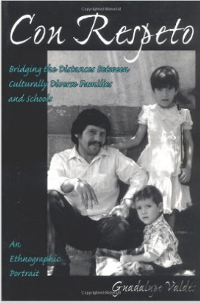
CASE #1
You have ten students in your class whose parents are Mexican immigrants. They sit quietly in the classroom, never participate or raise their hands to answer questions. Are they under-achieving students?
(Valdes, 1996, cover). Copyright by Teachers College Press
Notes:
[INSTRUCTIONS – After reading the scenario, give the participants a few minutes to think about their answer, and then ask them to discuss either in pair share or as a whole class depending on the size]
Case #1 is based on Guadalupe Valdez’ research with Mexican immigrant parents.
She noticed that the teachers were upset that the children from these families would just sit quietly in class, not raise their hands, not volunteer to answer questions. The teachers thought the students were not ‘good students’, that they were under-achieving.
When Valdez met the parents, she asked them for their idea of what a ‘good student’ is, and the parents all said that a good student is someone who sits quietly and listens to their teacher. This is what they had instructed their children as well, so the children were obeying their parents, not realizing that the expectations for being a good student in these American teachers’ classrooms was quite the opposite!

Slide 8
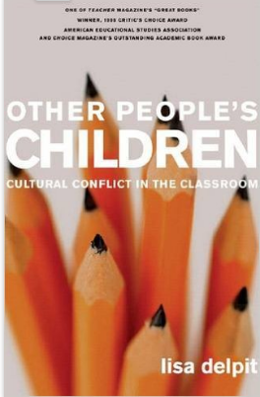
CASE #2
At the end of the art activity, as a preschool teacher, you notice that an African-American student continues to cut his turkey shape even though you have told him that “The scissors go in the box”. Is he being defiant deliberately?
(Delpit, 2006, cover). Copyright by The New Press
Notes:
[INSTRUCTIONS – After reading the scenario, give the participants a few minutes to think about their answer, and then ask them to discuss either in pair share or as a whole class depending on the size]
Case # 2 is based on research conducted by Lisa Delpitt.
She noticed that a teacher was getting frustrated by an African-American student in her class who she thought was being deliberately defiant. He wouldn’t listen her instructions and stop cutting his art work when it was time to stop and she told him that the scissors went in the box. Instead, he just kept cutting. If he kept this up much longer, she could refer him for a behavior disorder.
Delpitt, however, met the parents to get their perspective. The mother explained that if she wanted her son to do something, she used the imperative form of sentence, like “Go shower,” or “Put the pencil in the box”. The mother explained that her son heard the teacher’s “instruction” as information not as a directive. Yes, he knew the scissors went in the box and he would put them there when he was done cutting, but his teacher hadn’t told him to do so yet.

Slide 9
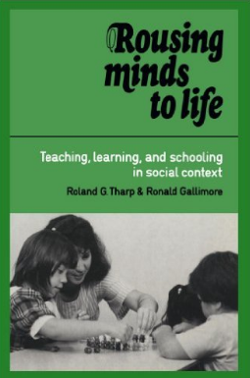
CASE #3
A kindergarten Hawaiian student continues to interrupt you during storytelling even after you have told her not to. Why do you think she does not follow directions?
(Tharp, & Gallimore, 1995, cover). Copyright by Cambridge University Press
Notes:
[INSTRUCTIONS – After reading the scenario, give the participants a few minutes to think about their answer, and then ask them to discuss either in pair share or as a whole class depending on the size]
Case # 3 is based on research that was conducted by Roland Tharp and Ronald Gallimore in Hawaii.
The preschool teachers were frustrated that their students would always interrupt during story-telling. Story telling, they said, was structured so that the students listened while the teacher told the story by reading from a book. Then after the story was narrated, they would ask questions to assess if the students understood the story.
By interrupting, the students were being rude and showed that they were unable to wait for their turn to speak.
The researchers met the families of these children and learnt that, in the Hawaiian culture, it is very appropriate to interrupt during story-telling.
It lets the narrator know that you are listening to them, and by finishing their sentence or adding to what they might say, it affirms what they are saying.
These students weren’t being rude, they were letting the teachers know they agreed with what they were saying and that they were enjoying their narration!

Slide 10
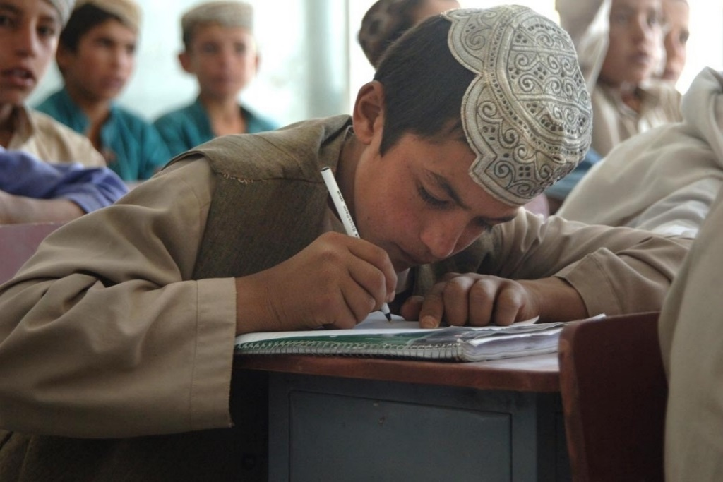
Case #4
An Afghani student refuses to clean up after play time or snack time. He tells you that at home, this is something his mother and older sisters do and he is not expected to clean up. Why do you think he refuses to clean up in the classroom?
School Back in Session by Staff Sgt. Marcus J. Quarterman. CC0
Notes:
[INSTRUCTIONS – After reading the scenario, give the participants a few minutes to think about their answer, and then ask them to discuss either in pair share or as a whole class depending on the size]
Case # 4 is based on a true story.
A preschool teacher was surprised when her student from Afghanistan said he wouldn’t clean up after himself. This was something that the womenfolk in his home did. A little taken aback, the teacher contacted the boy’s mother to find out what could be done about the situation. She thought about her own expectations for why she thought it was important for this preschooler to learn to clean up, and identified the underlying values in her expectations.
One, she realized, was the value of gender equality in American culture where chores were evenly distributed among men and women, so men as well as women would be expected to help with the housework and cleaning up.
Second was the value of being independent: this was a skill he needed to learn now so he could grow up to be an adult who could live by himself and take care of himself. However, when she met the mother, the mother explained that in their culture, the expectations and values were very different. They believed that roles were different for men and women and household chores were reserved for women while the men were expected to work outside the home.
They also believed that adults in a family were interdependent and, just as she now looked after her son, she expected that he would look after her when he grew up.
Presented with this different perspective, the teacher recognized that she would need to work out a compromise. She explained these differences in expectations to the mother and asked her what mutually acceptable solution they might be able to arrive at.
As they spoke, the mother became aware that her son would be expected to have these skills if he was to be successful and a productive citizen in the US, so she made the informed decision to allow the teacher to teach her son to clean up after himself in school.
However, the mother said, she would not place this demand on him at home where he would continue to respect their own traditions. The teacher agreed that this was an acceptable compromise.

Slide 11
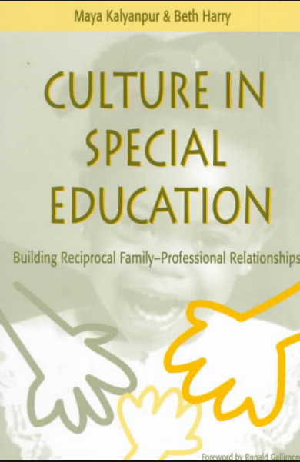
Case # 5
Annie is an African-American single mother. Her 5-year-old son has a disability. She has a good relationship with her Anglo-American social worker who visits her in her Section 8 apartment once a month. One time, Annie told the social worker that she beat her son when he was naughty. The social worker reported her to Child Protection Services. Is this the appropriate action?
(Kalyanpur & Harry, 1996, Cover). Copyright by Paul H Brookes Pub Co
Notes:
[INSTRUCTIONS – After reading the scenario, give the participants a few minutes to think about their answer, and then ask them to discuss either in pair share or as a whole class depending on the size]
Case # 5 is based on research conducted by Maya Kalyanpur and Shridevi Rao.
Annie, an African-American mother of a young boy with a disability was very upset that her social worker had reported her to Child Protection Services because she had told her that she beat her son one time when he was naughty.
The social worker had been visiting her for a year and she thought they had a good relationship.
Yet, when she told her this, the social worker didn’t make any effort to learn more about the situation and just went ahead and reported her for child abuse.
Annie went on to explain her perspective. She knew the difference between beating and abuse. “Abuse,” she said, “was when you do a number on the kid.” She wasn’t doing that. She had just spanked him once on his bottom when he didn’t listen and obey her instantly.
As she pointed out, living in public housing often meant being exposed to danger and it was a matter of life and death for her son to know the importance of instant obedience. Spanking him was a way to let him know how serious this was.
She wished that the social worker had taken advantage of the fact that the two of them had a good relationship and taken some time to hear more of her story. It might have caused her to change her mind about reporting her because she could have seen that this was not a case of abuse but a difference in parenting styles.

Slide 12

CASE #6
In a classroom, you observed a Black girl being pulled out of the classroom due to misbehaving according to the teacher. But when a White girl engage in the same behavior, the teacher does not pull the student out of the classroom. Why do you think the teacher handled the situation differently?
(Morris, 2016, cover). Copyright by The New Press
Notes:
[INSTRUCTIONS – After reading the scenario, give the participants a few minutes to think about their answer, and then ask them to discuss either in pair share or as a whole class depending on the size]
In Case # 6, Monique Morris writes about how African-American girls are being increasingly identified as having behavior or conduct disorders.
This phenomenon, which has resulted in the over-representation of minority students in special education, has affected African-American males most, causing what has come to be known as a “school to prison pipeline”.
Morris points out that the behaviors manifested by African-American girls are misunderstood when interpreted by white middle class norms of “good” behavior.
Black girls are greatly affected by the stigma of having to participate in identity politics that marginalize them or place them into polarizing categories: they are either ”good” girls or ”ghetto” girls who behave in ways that exacerbate stereotypes about Black femininity, particularly those relating to socioeconomic status, crime and punishment.
When Black girls do engage in acts that are deemed “ghetto’ – often a euphemism for actions that deviate from social norms tied to a narrow, white middle class definition of femininity they are frequently labeled as nonconforming and thereby subjected to criminalizing – such as being pushed out to programs for conduct disorders, alternative schools and eventually in juvenile criminal systems.

Slide 13

Case #7
At an IEP meeting, you become more and more uncomfortable as the parents kept saying “Jesus be praised!”
Meeting conference people by OpenClipart-Vector. CC0.
Notes:
[INSTRUCTIONS – After reading the scenario, give the participants a few minutes to think about their answer, and then ask them to discuss either in pair share or as a whole class depending on the size]
Case # 7 is based on my own experience of sitting in an IEP and realizing that I was becoming uncomfortable about something that eventually caused me to disengage from the proceedings.
Later, after the meeting, as I thought back to try and understand my behavior, I realized that the parents’ continued references to Jesus were what had set me off. This was a huge shock to me.
Although I am a Hindu and the parents were obviously Christian, I have always prided myself on being liberal and tolerant of other religions. Obviously I wasn’t as tolerant as I thought I was. I then realized there was another factor that had intruded.
Growing up in India, soon after independence from the British, the best schools were run by Christian missionaries. So if we wanted a good education, we had little choice but to attend these schools, although almost all of the students were non-Christian. A strong colonial legacy was the perception by the nuns that not being Christians made us pagans. I was proud to be Hindu and being told even obliquely that I was somehow lesser for not being Christian and a follower of Jesus affected my self-worth.
This deep-seated, even forgotten, feeling was triggered by the parents’ words, even though I was fully aware they were saying this to express their deep gratitude for all the effort we were putting in to help them and their son and for the progress their son was showing because of our efforts.
This disastrous (to me) meeting serves as a reminder of how taken for granted our values are and that we are all vulnerable to cultural blindness.
The next few slides describe the approach of cultural reciprocity as a means of building parent-professional relationships where professionals develop deeper understanding of parents’ culture through learning about their own values, and parents acquire social capital to navigate mainstream American culture and the culture of special education in particular.

Slide 14
FOUR STEPS OF CULTURAL RECIPROCITY
  1. Identify the cultural basis in your instructional practice
    Why do you do what you do in your classroom?
    Fill out your cultural identity web
  2. Identify the cultural basis in your student’s behavior if there is an incongruence
    Why does the student do what they do?
    Speak to the parents or guardians
  3. Make these differences in expectations explicit
  4. Work out a compromise
Notes:
There are four steps in cultural reciprocity.
Each of these steps will be explained in more detail.

Slide 15
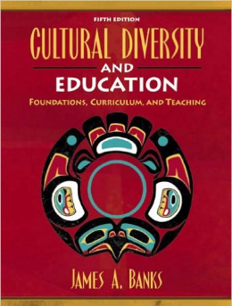
Step 1: identifying cultural assumptions in your teaching
Asking yourself “why?”
  Why do I want my student to walk in a line to get from one place to another?
  What are the imbedded values?
Recognizing “who am I?”
  Identifying the macro- and micro-cultural groups that make up who you are
    Socio-economic status/ class; Religion; Occupation; Ethnicity/ race; Age; Gender; Nationality; Birth order; Family relationship
Intersectionality
Positionality
(Banks, 2005, cover). Copyright by Pearson
Notes:
The first step involves identifying the cultural assumptions in one’s teaching.
There are two parts to this.
First, as professionals, we need to ask ourselves “why?” In this example, we might ask why we want our students to walk in a line to get from one place to another. The reasons may be because of some underlying values. Perhaps because safety is important in this litigious culture of accountability.
For instance, we are accountable for our students’ safety and having them walk in a line at an even pace (“Walk, don’t run”) ensures that they will get to their destination safely. Perhaps because we like children to learn discipline. They must learn the rules for indoor behavior and remain orderly; only in the gym are they permitted to run and shout.
Perhaps it is because we know that there will be enough for everyone when you get there.
Think about it.
When do lines break down?
When there isn’t enough for everybody and everyone has to manage for themselves.
Second, we need to identify the macro and micro-cultures that make up who we are.
This is based on James Banks’ model of cultural identity.
Examples of macro-cultures might be nationality or race, especially if from the dominant or mainstream race.
Examples of micro-cultures might be birth order, age, or occupation.
Each of these variables influences who we are and each intersects in ways that make us unique. We may also emphasize different aspects of ourselves at different times and places; some variables may be more salient than others.
For instance, as I grow old, my age is more salient to me than being a woman but less salient than being a woman of color, since the intersection of gender and ethnicity affects my life in the US more strongly than just my gender.

Slide 16








CULTURAL IDENTITY
Nation
Community
Family
Geography
Education
Gender
Faith
Race
Age
Dis/Ability
Ethnicity
Language
Adapted from Banks (2005, p.52)
Notes:
Banks’ cultural identity web names several variables including
Religion
Class
Exceptionality
Race
Gender
Ethnicity
Language
Nationality
Geography
This list is by no means exhaustive.
You could add any others salient to you to create your own cultural identity web that is unique to you.

Slide 17
activity #1
Fill in your cultural identity web: Identify aspects of your macro- and micro-cultures, intersectionality and positionality.
Discuss your cultural identity web with the person sitting next to you
Nation
Community
Family
Geography
Education
Gender
Faith
Race
Age
Dis/Ability
Ethnicity
Language
Adapted from Banks (2005, p.52)
Notes:
You could use the aspects of the web that Banks has named or you could use others that resonate more with your self.
Be sure to consider which aspects are more salient to you and why (positionality) and how some aspects might intersect to become more powerful or to increase your vulnerability further.
Once you have fleshed out your cultural identity web, discuss this with someone.
Spend some time identifying some of the embedded values that are often associated with these aspects; look at what you take for granted and how this influences your behavior.
I will illustrate the steps of this process with an anecdote from my own professional experience. (You can substitute your own anecdote here. Be sure to make the four steps of the process explicit as you do so.)
As a special education professional, I believe with passion in the benefits of inclusion and the importance of ensuring that all children with disabilities receive an appropriate education. When I was working with the government Ministry of Education in Cambodia, I traveled around the country meeting with parents of children with disabilities to tell them about the government initiative in inclusive education that would give their child an exciting opportunity to receive an education. I believed this would change the children’s lives. That was the value I brought from my cultural identity web.

Slide 18

Step 2: identifying cultural assumptions in student’s behavior
Asking the parent “why?”
  Speak to the student’s parent or guardian
  Find out if there are differences in your assumptions and theirs.
Two people speaking by Mscharwies. CC0
Notes:
The next step is trying to find out if the parent thinks differently.
To continue with my story, when I met a family whose 12-year-old blind daughter had never been to school, I immediately set about trying to convince them that they should send her to the neighborhood that had just begun to offer inclusive education for children like her.
The parents who were rice farmers, however, were reluctant.
They thought she was too old to start school at such a late age.
They also thought she was “useless.” They said: She couldn’t even plant rice!
Listening to them, my ministry colleagues and I realized that there were some differences in our assumptions and theirs.

Slide 19


Step 3: make these differences explicit
By explaining your expectations, you provide the parents with “social capital” (also called “cultural capital”) or the knowledge to understand our mainstream culture and to navigate through it.
You also help them to make an informed decision
Country road vector illustration by OpenClipart. CC0
Notes:
We explained why it was important for their daughter to go to school and to receive an education, even more so because she couldn’t plant rice.
But, as we continued our conversation, we began to recognize that, for the family, it was more important that their daughter contribute to the family income than go to school.
We knew we would have to focus on making her economically productive before the parents would consider the possibility of her going to school.
We had to figure out a way to teach her to plant rice.

Slide 20
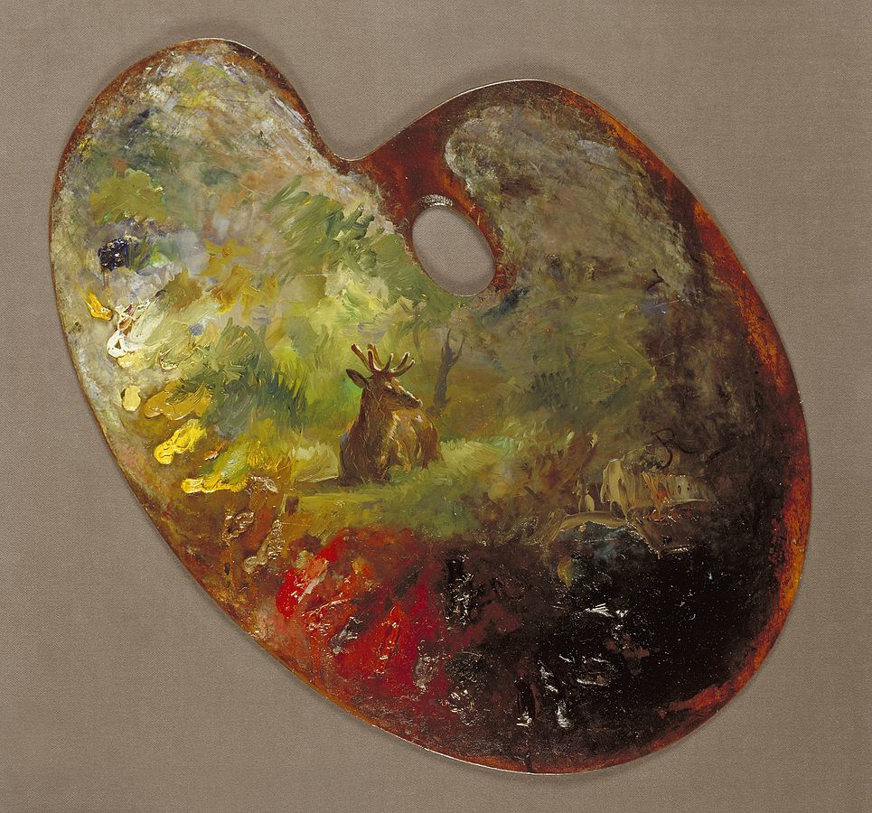
Step 4: work out a compromise
Respect the parents’ culture, their values and beliefs.
Negotiate a middle ground
  A “mélange of styles” (Ballenger, 2004)
Being uncomfortable is okay.
Palette by Rosa Bonheur. CC0
Notes:
So we worked out a compromise.
We learned that planting rice is a two step process. In the first, the seeds are thrown at random in the rice bed. The daughter could do this with no problem, as long as she kept her hand movements small.
But the next step was more complicated: the seedlings needed to be transplanted in even rows, each at even distances.
For this, we created a small tool, two sticks tied together by a long string the length of the rice bed, with knots evenly placed along its length. Each of the sticks would be placed at opposite ends of the rice bed, and the daughter could feel the knots with her hand and know where to transplant the seedling.
With this arrangement, we were respecting the parents’ values and helping their daughter become a productive member of their family.
The parents were so pleased they ended the conversation saying they would think about sending her to school so she could learn.
It was what Cynthia Ballenger called a “mélange of styles”; my ministry colleagues and I were okay about being uncomfortable while we sorted through the dilemma and worked out a solution.

Slide 21
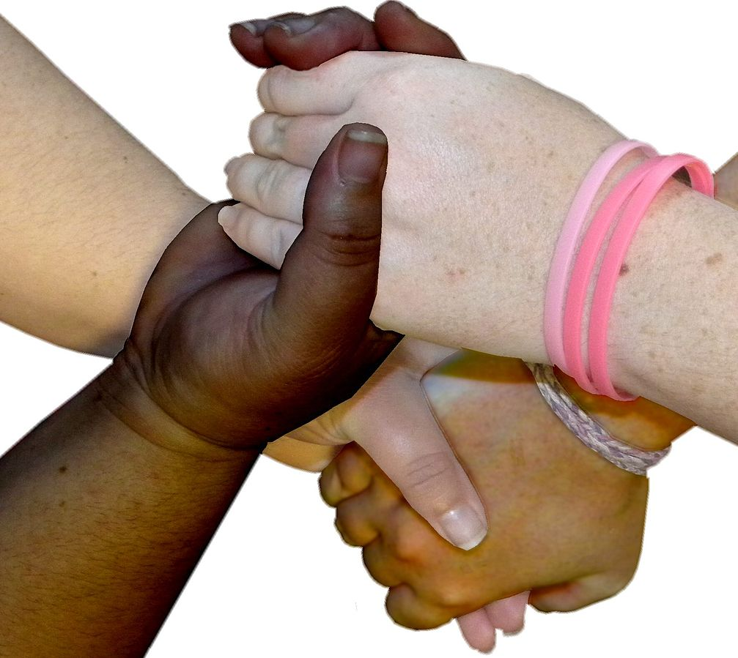
Group activity #2
Apply the approach of cultural reciprocity:
  Think of a situation where a student might be presenting challenging behavior
  What are your expectations? Why?
With the group or the person sitting next to you:
  Try to analyze what the parent’s expectations might be and how they differ from yours.
  Work out a possible compromise.
Four hands holding by Vicki Nunn. CC0
Notes:
[INSTRUCTIONS - At this point, ask the participants to think of an example of their own and work through it using the steps of CR.]

Slide 22
ADDITIONAL Resources
IRIS module on “Cultural influences on behavior”
Culture’s influence on behavior doesn’t stop at the classroom door.
How culture may impact behavior in the classroom
The WEIRD Science of Culture, Values, and Behavior
What is cultural reciprocity?
What is cultural reciprocity in special education and why does it matter?
Culturally Sensitive Individualization of Services and Supports

Slide 23
Resources CITED
Anonymous. (Photograph). (2017, April 05). books feet legs person reading [digital image]. Retrieved from here. CC0
Banks, J. A. & McGee-Banks, C. (2010) Multicultural education: Issues and perspectives. New York: John Wiley & Sons.
Banks, J. A. (2005). Cultural diversity and education: Foundations, curriculum, and teaching. Pearson.
Bonheur, R. (n.d.). Palette [ digital image]. Retrieved from (here). CC0
Delpit, L. (2006). Other People's Children: Cultural Conflict in the Classroom. New York: W.W. Norton
Kalyanpur, M. & Harry, B. (2012). Cultural reciprocity in special education: Building reciprocal family-professional relationships. Baltimore: Brookes.
Kalyanpur, M. & Harry, B. (1999). Culture in special education: Building reciprocal family- professional relationships. Baltimore: Brookes.
Mscharwies. (2018 May, 1). Two people speaking [clipart]. Retrieved from (here). CC0
Morris, M. W. (2016). Pushout: The Criminalization of Black Girls in Schools. New York: New Press

Slide 24
Resources CITED (2)
Nunn, V. (2010, November 17). Four hands holding [a photograph]. Retrieved from (here). CC0
OpenClipart. (2015, May 14) Country road vector illustration [clipart]. Retrieved from (here). CC0
OpenClipart-Vectors. (n. d.). Meeting conference people [a clipart]. Retrieved from (here). CC0
OpenClipart. (n. d.). Boy sitting on book and reading book [a clipart]. Retrieved from (here). CC0.
Tharp, R. & Gallimore, R. (1995). Rousing Minds to Life: Teaching, Learning, and Schooling in Social Context. New York: Press Syndicate
Quarterman, M. J. (Photograph). (2007, June 16). School Back in Session [digital image]. Retrieved from here. CC0
Valdes, G. (1996). Con respeto: Bridging the Distances Between Culturally Diverse Families and Schools. New York: Teachers college Press

