Slide 1
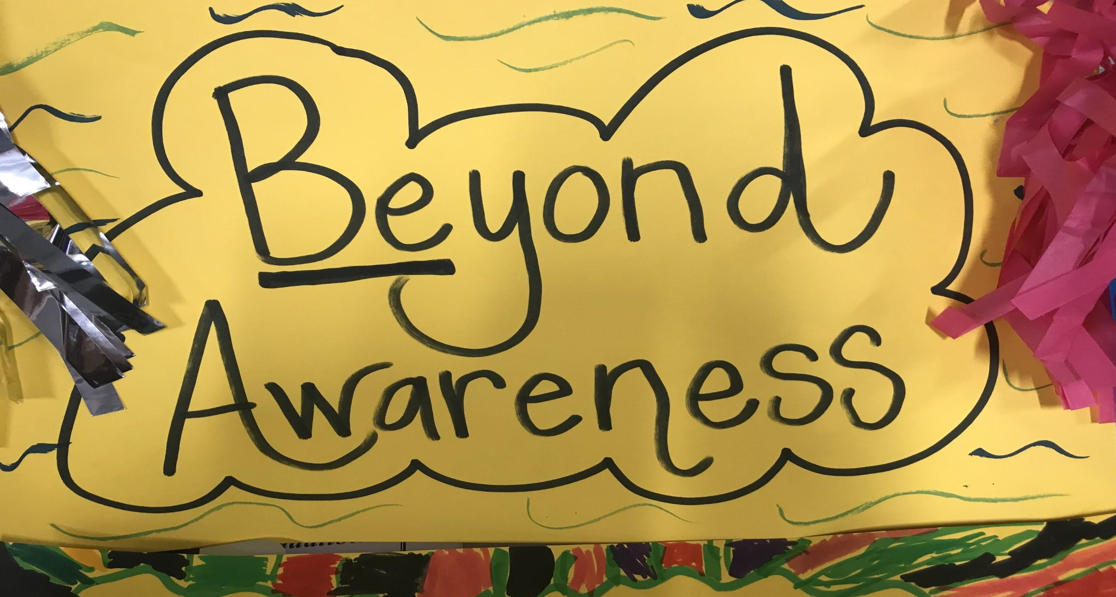
Beyond Awareness
Beyond awareness poster by Diana Pastora Carson. CC0 1.0
Created by Diana Pastora Carson, M.Ed.
as part of the Leaders for Inclusion Project at the University of San Diego and generously funded by the Johnson Family Foundation
@DianaPastoraCarson
Notes:
Today we want to share an exciting concept with you that we also want to share with our students in the upcoming months/year as part of our social skills/MTSS/anti-bullying (whatever fits for your school) focus.
[INSTRUCTIONS – Ask the participants - How many of you have ever participated in a disability awareness experience? And how was it? What did that look like?]
Thank you. So we’ll be briefly sharing about past ways of doing disability awareness and current research-based models for disability awareness.

Slide 2
Disability Studies in Education Tenets
To engage in research, policy, and action that
contextualize disability within political and social
privilege the interest, agendas, and voices of people labeled with disability/disabled people
promote social justice, equitable and inclusive educational opportunities, and full and meaningful access to all aspects of society for people labeled with disability/disabled people
assume competence and reject deficit models of disability
@DianaPastoraCarson
Notes:
The series of resources and workshops created by the Leaders for Inclusion project, from which this is borrowed, is based on the tenets of Disability Studies in Education.
This field encourages educators “to engage in research, policy, and action that
contextualize disability within political and social
privilege the interest, agendas, and voices of people labeled with disability/disabled people
promote social justice, equitable and inclusive educational opportunities, and full and meaningful access to all aspects of society for people labeled with disability/disabled people
assume competence and reject deficit models of disability
Beyond Awareness is focused on all of the Disability Studies in Education Tenets.
It simply breaks them down into some foundational categories that give a context for educators of all ages and subjects.
Those foundational categories are called the Five Fundamentals for Going Beyond Awareness

Slide 3
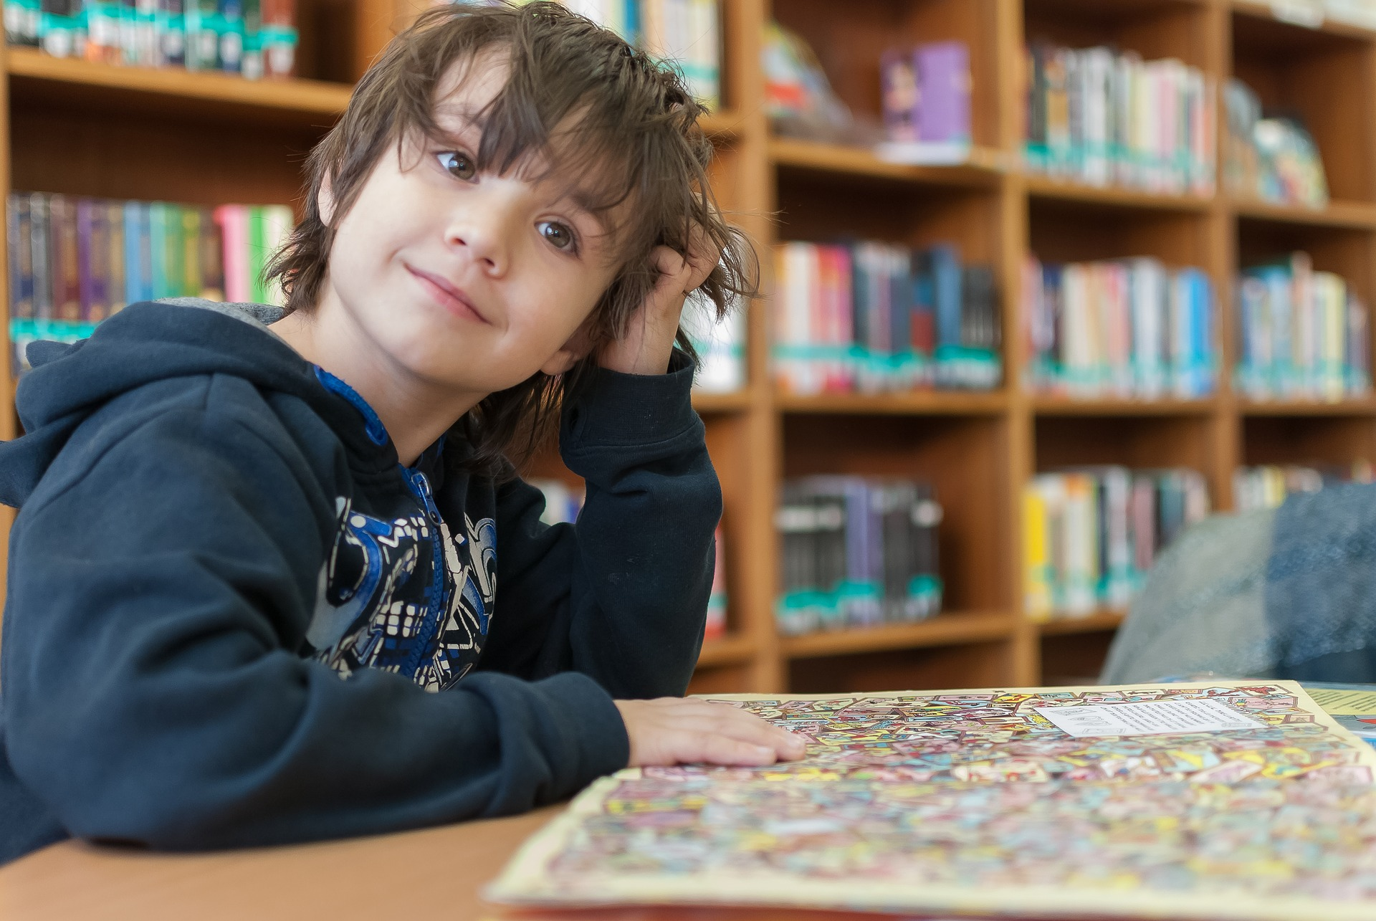
Disability Awareness: What is our purpose?
Self library education inside by Franck Barske. CC0
@DianaPastoraCarson
Notes:
[INSTRUCTIONS – break up the participants in groups and ask them to discuss “When you think about disability awareness, what does it mean to you? What is the purpose?”]
[INSTRUCTIONS – after the participants discuss in groups, ask them to share out loud. Acknowledge each share with gratitude.]
Historically, when we have discussed ability awareness or disability awareness, we have done simulation activities, pretending to be blind or deaf or to have a learning disability or to use a wheelchair. We assumed that we now understood how hard life must be for these individuals based on their condition. We followed societal perceptions of what it means to have a disability. This includes judgments and pity about the experience of having a body or mind that is different. But this way of thinking leaves out a major component of the experience of disability. It leaves out the coexisting experience of being “disabled” by our societal attitudes and inaccessible world.
When we have focused on how a person’s body or mind is different, yet have not focused on how society makes life inaccessible for people with disabilities, we have only reinforced the idea of differentness, otherness, etc., and have not acknowledged societal responsibility for our hand in “disabling” others. If we continue to do disability awareness the same way we’ve always done in the past, we will get the same results we’ve always gotten: pity, fear, bullying, exclusion, and inaccessible opportunities and environments.
So if our purpose is to facilitate empowerment of people with disabilities, then we need to reassess the impact of our methods and our content.

Slide 4
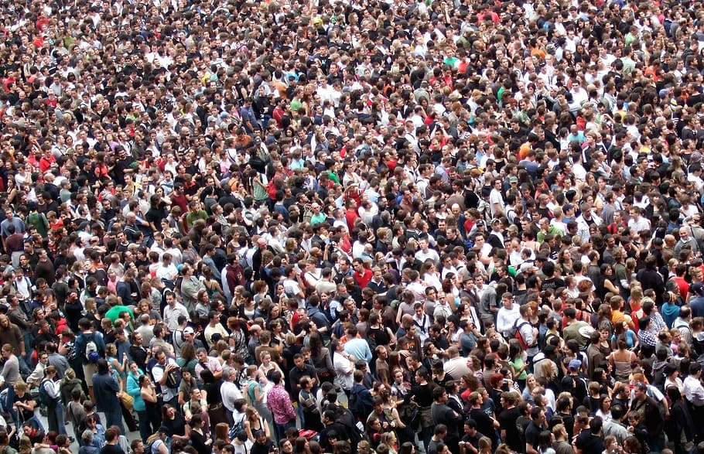
What needs to change?
People with disabilities?
Or Society?
Disabled and Here by Chona Kasinger. CC0
Large group of people by DMCA. CC0
@DianaPastoraCarson
Notes:
Putting it another way, what we’ve done in the past was show what was “wrong” with people with disabilities and completely omit what was wrong with society.
By doing this, we gave people insight into what it MIGHT be like to have an impairment, but not into what discrimination based on disability feels like.
More specifically, we did not teach what it is like to be disabled by one’s community as opposed to one’s mental, physical, developmental, or sensory difference.
By focusing on the “impairment” aspect of the disability experience, we have avoided the subject of ABLEISM (which we’ll go over in a few minutes), and by doing so, we have inadvertently been condoning it.
In the context of disability awareness, If we truly want change for our students and our future, then we need to focus on societal change.
I/we attended a weeklong fellowship training at the University of San Diego and learned some alternatives, based in disability research, that I’ll/we’ll be sharing with you today. With this information, we have the opportunity to change the course of education as it relates to diversity and disability, social-emotional development of our students, and our own understanding of how we support students with disabilities.
How can we be the change in terms of disability sensitivity?
Our plan is to empower our school with information to help us BE the change we wish to see. We will be working with five fundamental areas that we believe will take us beyond simply creating awareness of differences, but instead to a place of appreciating people’s different journeys and experiences, while helping students and staff to understand society’s role in disabling others, as well as society’s ability to make positive change by supporting access and inclusion. We believe that by doing this, we can impact the future more powerfully in a positive direction.
(Quote by Mahatma Gandhi)

Slide 5
“Be the change you wish to see
in the world.”
How can we be the change in terms of disability sensitivity?
@DianaPastoraCarson
Notes:
Our plan is to empower our school with information to help us BE the change we wish to see.
We will be working with five fundamental areas that we believe will take us beyond simply creating awareness of differences, but instead to a place of appreciating people’s different journeys and experiences, while helping students and staff to understand society’s role in disabling others, as well as society’s ability to make positive change by supporting access and inclusion.
We believe that by doing this, we can impact the future more powerfully in a positive direction.
(Quote by Mahatma Gandhi)

Slide 6
When we begin to understand our role in disabling others, we can begin to empower us all.
Diana Pastora Carson
@DianaPastoraCarson
Notes:
And so this must be our task, to understand the disability experience, and teach children and youth about OUR role in disabling people.

Slide 7
Five Fundamentals
Ableism
Accessibility
Assistive Technology
Disability Rights/Disability Civil Rights History
Respectful Language
Hands of different color by openclipart. CC0 1.0
@DianaPastoraCarson
Notes:
[INSTRUCTIONS - Read slide.]
Each of these five fundamentals is critical as a foundation for community understanding of how society can either empower, or disable.
Let’s take a look at what each one encompasses.

Slide 8
-isms
What are some -isms you know of?
What do they mean?
What do they do?
@DianaPastoraCarson
Notes:
We’ll start with Ableism.
But before that, what are some other isms you know of?
[INSTRUCTIONS – ask the participants for input (maybe write different ‘isms down on a chart as participants call them out)]
Based on what characteristics do we marginalize and discriminate against people?
Possible answers:
Race
Gender
Gender identity
Religion
Socio-Economic status
Political affiliation
And we have words that describe societal biases toward groups of people in said categories. You’ve heard of racism? You’ve heard of sexism? Any other isms?
What do they mean?
Possible answers:
Discrimination against a person or persons based on a trait that is perceived to be too different from the norm
Negative attitude toward a person or persons based on...
What is their impact or what do they do?
Possible answers:
Perpetuate fear/hate
Create division/otherness
Excuse mistreatment
Acknowledge responses with gratitude.

Slide 9
Have you heard of Ableism?
The practices and dominant attitudes in society that devalue and limit the potential of persons with disabilities
A set of practices and beliefs that assign inferior value (worth) to people who have developmental, emotional, physical or psychiatric disabilities
-ableism.org
@DianaPastoraCarson
Notes:
Ableism is one of the -isms.
[INSTRUCTIONS – ask the participants - How many of you have heard of Ableism before today?]
Discrimination against people with disabilities is called Ableism. And it isn’t always an obvious thing. In fact, many of you have not heard of it because it’s not something that is recognized within society in general.
Ableism often looks like charity or pity or even a focus on inspiration.
Most people have no idea that they’re being ableist, and sometimes discussions about ableism can be confrontational or confusing at first, but ableism has long term effects on people’s lives. And the best way to discover our own ableism is to meet people who live the experience of disability on a daily basis.
So that is a big part of our plan. We will be bringing people to our campus to meet students and share their lives with them, as well as share five basic concepts that will guide our school to moving “beyond awareness.”
What we want to do is shed light on this concept so that students become aware of their own ableist attitudes that impact life quality for people with disabilities.

Slide 10
Ableism
Ableism = Discrimination
Ableist attitudes & assumptions are “disabling.”
“Ableism is systematic, institutional devaluing of bodies and minds deemed deviant, abnormal, defective, subhuman, less than. Ableism is violence.” - Autistic Hoya
We often unknowingly demonstrate ableism by our words and actions.
@DianaPastoraCarson
Notes:
Unpacking the multitude of ways that our society is generally ableist can take years. However, our goal is to shine light on ableism and to grow as a community that aims to demonstrate that we do value all people.
If we look at ableist words, we could list:
Retard
Retarded
Wheelchair-bound
Confined to a wheelchair
Crazy
Idiot
Lame
Lunatic
and so many more terms that are used with a negative slant toward something by referencing disability.
This is only the tip of the iceberg. There are so many more that we as a school community can explore together..
If we look at our actions, we’d need to unpack years and years of stories and experiences that are ableist in nature. Here are a few examples:
A wheelchair user wants to go to a play or a restaurant, yet the design of building does not provide access for the wheelchair. The designer was ableist. The event planner was ableist. The event is ableist. Inaccessibility in general is founded in ableism.
When there are two people together - one who is disabled, and one who is not - and a stranger interacts only with the person who does not visibly experience disability (i.e., does not use a wheelchair or walker or cane, etc.). Not speaking directly to a person with a disability assumes that they are not capable or possibly not worthy of that interaction. This is ableist.
Speaking to a person with a disability as if they were a child is ableist.
Speaking about a person with a disability (i.e. student) to another person and not including them in the conversation (regardless of their verbal ability) is rude and ableist.

Slide 11
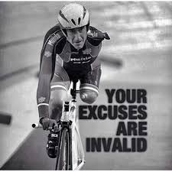
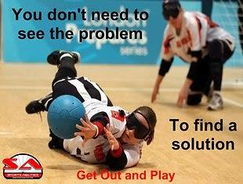
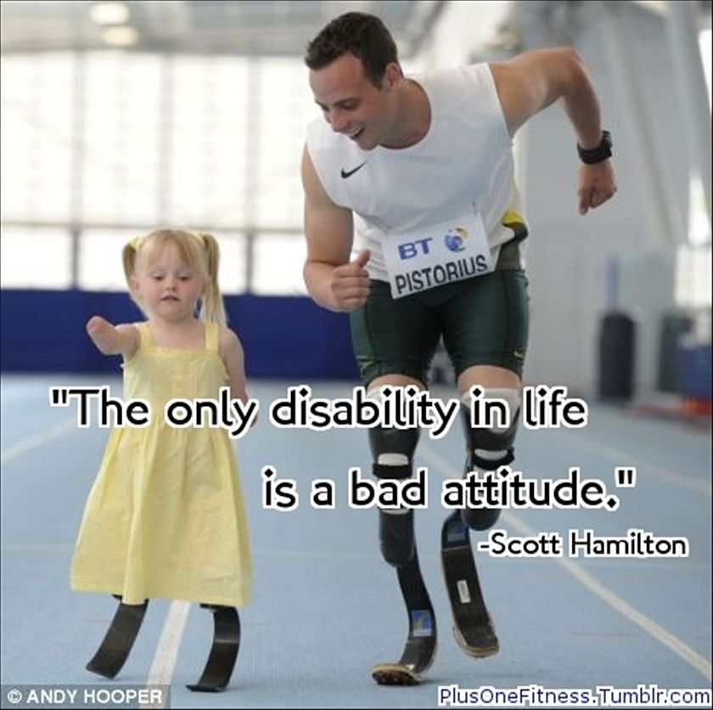
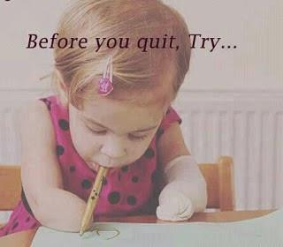
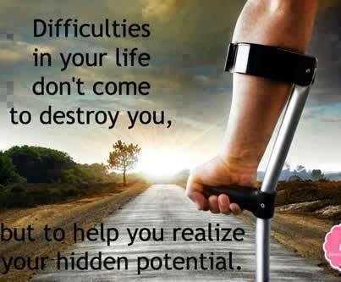
Inspiration Porn Examples
@DianaPastoraCarson
Notes:
Inspiration porn is where ableism abounds.
“Inspiration porn, in a nutshell, is when a disabled person is viewed as “inspirational,” “brave,” or “special” for achieving ordinary, everyday tasks.” -TheBodyIsNotAnApology.com.
In the media and in daily conversations, we tend to view people with disabilities out shopping or playing or participating in life as inspirational. We sometimes cry or get goosebumps when we see someone with a disability competing in sports or talent shows.
It is important to ask ourselves why.
You’ve seen the internet posts stating that “The only disability in life is a bad attitude?” If you put that statement on a photo of a wheelchair at the bottom of a staircase, you quickly realize that there is no positive attitude that could make this situation nondisabling.
Inspiration porn makes us feel good about our nondisabled selves at the expense of the dignity of people who experience disability. It is ableist. Stella Young has a powerful TED Talk on Inspiration Porn. https://www.ted.com/talks/stella_young_i_m_not_your_inspiration_thank_you_very_much
The point is, we objectify and use disabled people to get a point across or to inspire people. And it is offensive and viewed as ableist by many people in the disability community.
These are just some foundational examples of ableism. Let’s continue with the other 4 of the fundamentals.

Slide 12
Access
Accessibility to buildings, events, educational opportunities, relationships, communication, etc.
If a person has ACCESS, they are less DISabled.
ACCESS is a function of one’s community and surroundings, not one’s condition.
Accessibility requires an understanding of what barriers to inclusion and life quality are, and a commitment to removing barriers
Inaccessible environments and events are the result of ableist ways of thinking.
@DianaPastoraCarson
Notes:
[INSTRUCTIONS - Read slide.]
It is important for students to understand that people with disabilities are much less disabled or not disabled at all, perhaps, when they have access to the same things that nondisabled people have access to.
It is also important for students to understand that society plays a part in either ensuring access for all, or creating and permitting barriers. We disable when we disregard access for all. Ableism leads to inaccessible lives.

Slide 13
Assistive Technology
Any high or low tech device or assistance that helps a person to be more independent.
An important factor in one having ACCESS to many things that nondisabled people have access to.
Some Examples: Vibrating alarm clock, rotating spatula, service animals, cross-walks with audio signals, sensory tools, iPad, speech/language programs, open-captioning, eye gaze technology, supported typing, any technology that supports communication, etc.
@DianaPastoraCarson
Notes:
[INSTRUCTIONS - Read slide]
Without assistive technology, people with disabilities often do not have access to the same things that nondisabled people have access to. Students need to understand that assistive technology provides for independence and dignity, and levels the playing field for people with disabilities.

Slide 14
Assistive Technology (cont.)
Lack of needed assistive technology is the result of ableist thinking that limits access to opportunities and environments that nondisabled people do have access to.
@DianaPastoraCarson
Notes:
[INSTRUCTIONS - Read slide]
Without assistive technology, people with disabilities often do not have access to the same things that nondisabled people have access to.
Students need to understand that assistive technology provides for independence and dignity, and levels the playing field for people with disabilities.

Slide 15
Disability History
Disability Civil Rights History
Serves as an education to our youth (and adults) that Disability History is CIVIL RIGHTS history.
Teaches that ACCESS to life and inclusion in life is a CIVIL RIGHTS issue, not just a nice thing to do.
Shares the lives of important pioneers who made community access a reality for many people.
Gives youth a deeper understanding of discrimination and ableism.
@DianaPastoraCarson
Notes:
Disability Rights are Civil Rights is a slogan often used in the disability advocacy community.
We can call it disability history, disability rights history, or disability civil rights history.
Whatever we call it, we need to make sure that students understand that disability history is not separate of all the other civil rights movements, but it is a very active, and much needed part of the civil rights movement.

Slide 16
Respectful Language
Teaches youth about the stigma perpetuated by verbally associating disability-related conditions with negativity, put-downs, and low expectations.
Teaches students to honor each person’s chosen way to identify themselves, either in Person-First language, or in Identity-First/ Disability Pride language.
Reminds youth that we are all important and special, and that words do matter.
@DianaPastoraCarson
Notes:
Respectful Language teaches youth about the stigma perpetuated by verbally associating disability-related conditions with negativity, put-downs, and low expectations. This is related to what we discussed earlier about ableist language.
Respectful Language teaches students to honor each person’s chosen way to identify themselves, either in Person-First language, or in Identity-First/ Disability Pride language. We will learn more about Person-First and Identity-First language as we move beyond awareness.
Respectful Language reminds youth that we are all important and special, and that words do matter. (This might tie in with your school’s social skills program, which you might want to mention here.)

Slide 17
Beyond Awareness Essentials
The Five Fundamentals
Beyond Awareness Library Collection
@DianaPastoraCarson
Notes:
So we’ll be forming our Beyond Awareness activities around these five fundamental areas, and we’ll also be building a library collection that is based in diversity and inclusion and reflects these fundamentals.

Slide 18
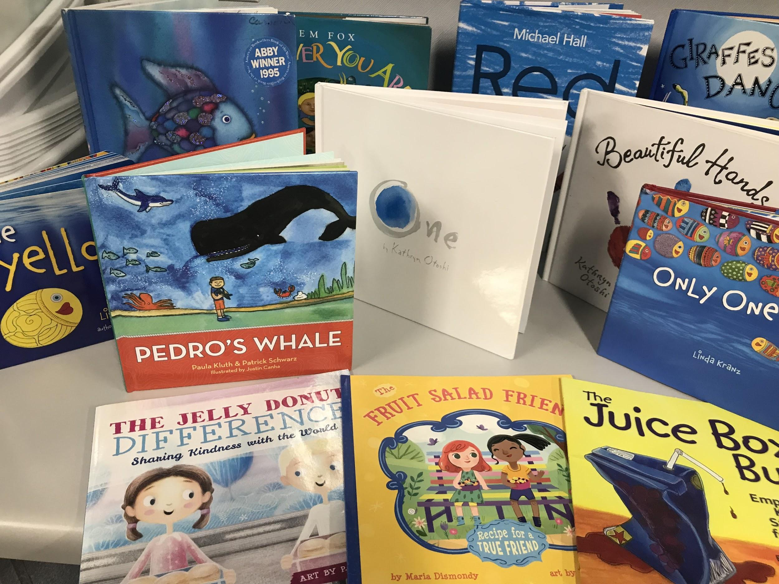
Funding Ideas $$$
Books & media that facilitate dignifying images of people with disabilities & embrace diversity
Children’s book on the table by Diana Pastora Carson. CC0 1.0
@DianaPastoraCarson
Notes:
We’ll be investigating funding options for these books and media. And if you’ve got ideas for how we can build this library for our students, we welcome your input and support!

Slide 19
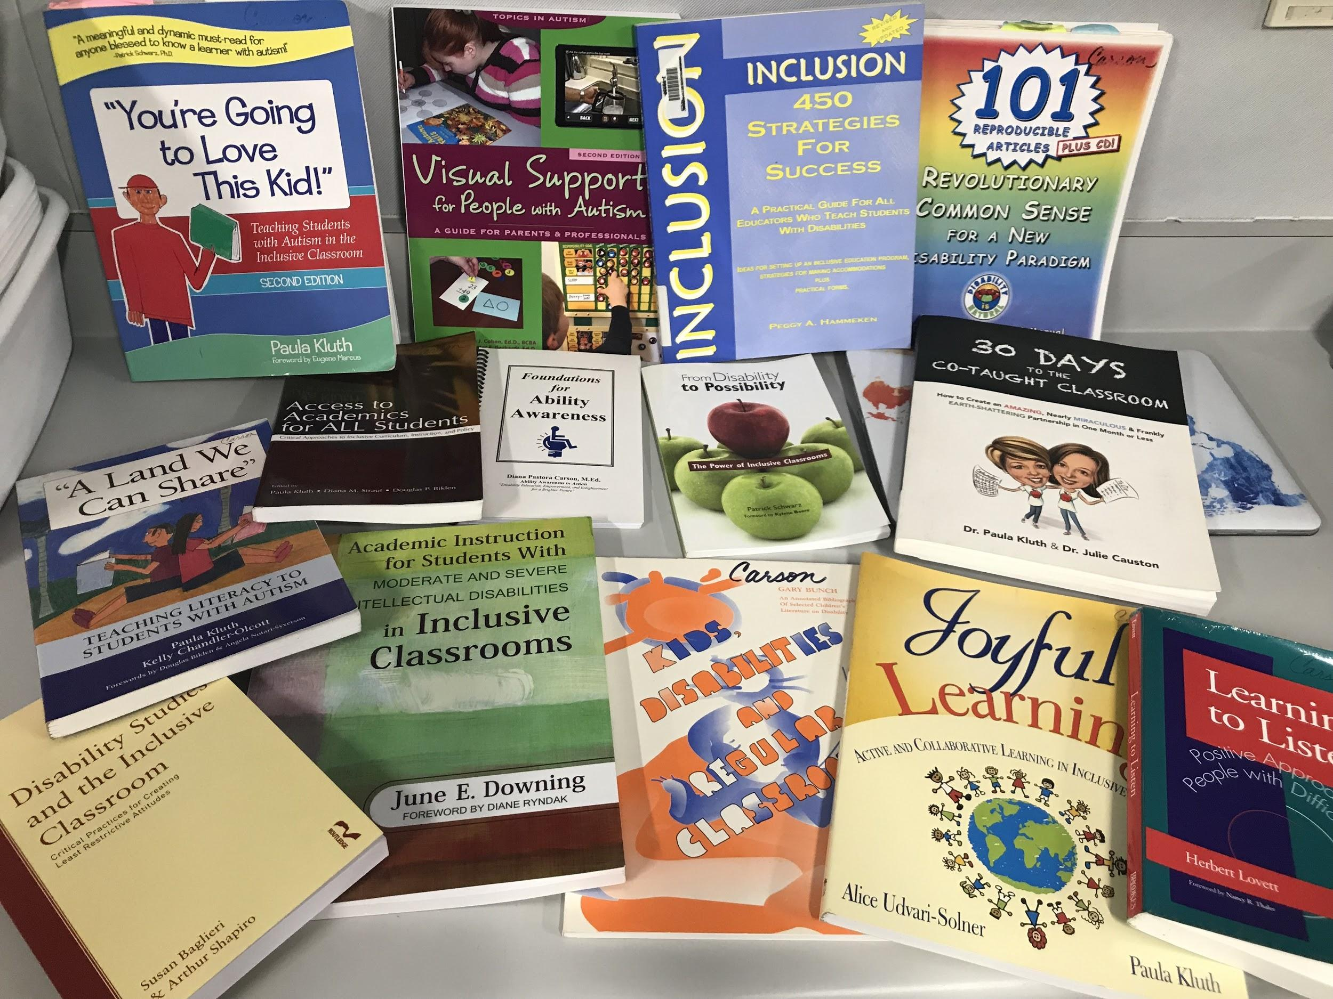
Inclusion & Disability-Related Resources
Teacher books by Diana Pastora Carson. CC0 1.0
@DianaPastoraCarson
Notes:
We can also create or add to our resource library for staff.
Anything by Paula Kluth, Julie Causton, Kathie Snow are great professional resources for inclusion.

Slide 20
Out with the Old…
Simulation activities as the sole means of “educating” students
“Experts” telling us about “disabilities”
“Disability” is viewed as a physical, mental, or developmental condition that needs to be fixed
Activities and speakers that elicit pity or misguided inspiration
@DianaPastoraCarson
Notes:
These are things that society typically has done for “ability awareness” or “disability awareness” events.
We won’t be doing any of these as they perpetuate ableism.

Slide 21
In with the New…
Inclusion (or at least modeling an inclusive mindset) as a foundation
Diversity appreciation as a foundation
Experts/Speakers are people who experience disability
“Disability” is viewed from the Social Model
Speaking topics revolve around the five fundamental areas
@DianaPastoraCarson
Notes:
Here are the things we will focus on instead:
[INSTRUCTIONS – Read the slide]

Slide 22
Going Beyond Awareness
Annually
Host Beyond Awareness Celebrations
Throughout the Year
Embed Tenets of DSE &
Five Fundamentals of
Beyond Awareness in classroom curriculum & environments and in extracurricular activities.
Streamers Decoration Confetti Party Celebration by Max Pixel. CC0
@DianaPastoraCarson
Notes:
So there are two approaches to moving our school in a beyond awareness direction. One is to have an annual celebration. And the other is to sponsor activities throughout the school year that focus on the Disability Studies in Education Tenets and the five fundamentals of Beyond Awareness, through guest speakers who experience disability..
Read slide.
We can choose to ease in and use one approach the first year and expand next year, or aim for both approaches from the get-go. The important thing is that the five Beyond Awareness fundamentals and the Disability Studies in Education Tenets are the focus of our efforts.

Slide 23
Ideas for Throughout the Year…
Inclusive Education!
Beyond Awareness Library Collection
Announcements
Clubs
Chorus
Drama
T-Shirts
Guest Speakers & Assemblies
Battle of the Bands
Debate Forums
Writing Campaigns
Book Clubs
Media Productions
Contests (Art/Speech/Writing)
Curricular Projects
@DianaPastoraCarson
Notes:
Here are just a few ideas of ways we can foster a beyond awareness experience throughout the school year.
[INSTRUCTIONS - read the slide]
Inclusive Education! -The first is inclusive education. When we include (truly include and create a sense of belonging for) all students in all aspects of education, including classes, extracurricular activities, field trips, conversations, decision-making, relationships with peers and staff, etc., we are modeling the Tenets of Disability Studies and we are exposing our students to opportunities to organically learn about Ableism, Access, Assistive Technology, Disability Rights, and Respectful Language. The belief in and practice of inclusion is a powerful foundation for moving beyond awareness and into complete diversity appreciation.
Beyond Awareness Library Collection (as previously discussed)
Announcements (We can have morning announcements giving fun facts about disability history, assistive technology, accessibility, modified sporting events, etc.)
Clubs (American Sign Language Club, inclusive chorus or art clubs, etc.)
Drama Classes that focus on social issues of diversity and inclusion
T-Shirts - We can have school t-shirts made that focus on Beyond Awareness concepts for school spirit (we’d need to get a grant or donations from the community). We can hold a logo contest and put the winning logo on the t-shirt.
Guest Speakers & Assemblies -This is a big part of Beyond Awareness. When we bring in speakers with disabilities to speak to our students (about any curricular topics as well as Beyond Awareness topics, students naturally lessen preconceived ableist notions.
Battle of the Bands - We could have students sign up to perform their original music composed intentionally with a message of inclusion & diversity appreciation.
Debate Forums - We can hold debate forums on topics related to disability
Writing Campaigns - Some classes or schools have writing campaigns for students to get involved with issues that affect people with disabilities.
Book Clubs - We can have book clubs with books related to disability
Media Productions - Some schools have media production classes and can have students produce public service announcements, mini-documentaries, commercials, etc. related to current disability topics, disability history, anti-bullying issues, respectful language, etc.
Contests - Students can compete in contests where the product relates to messages of moving Beyond Awareness (Art/Speech/Writing/Poster).
Curricular Projects - Teachers can embed the Disability Studies in Education Tenets and/or the Five Fundamentals of Beyond Awareness into the curriculum and empower students to critically think about ableism and how we can make a difference for the belonging of all people.
You may also have some ideas that will help to spread the message for moving beyond simple awareness of disabilities.

Slide 24
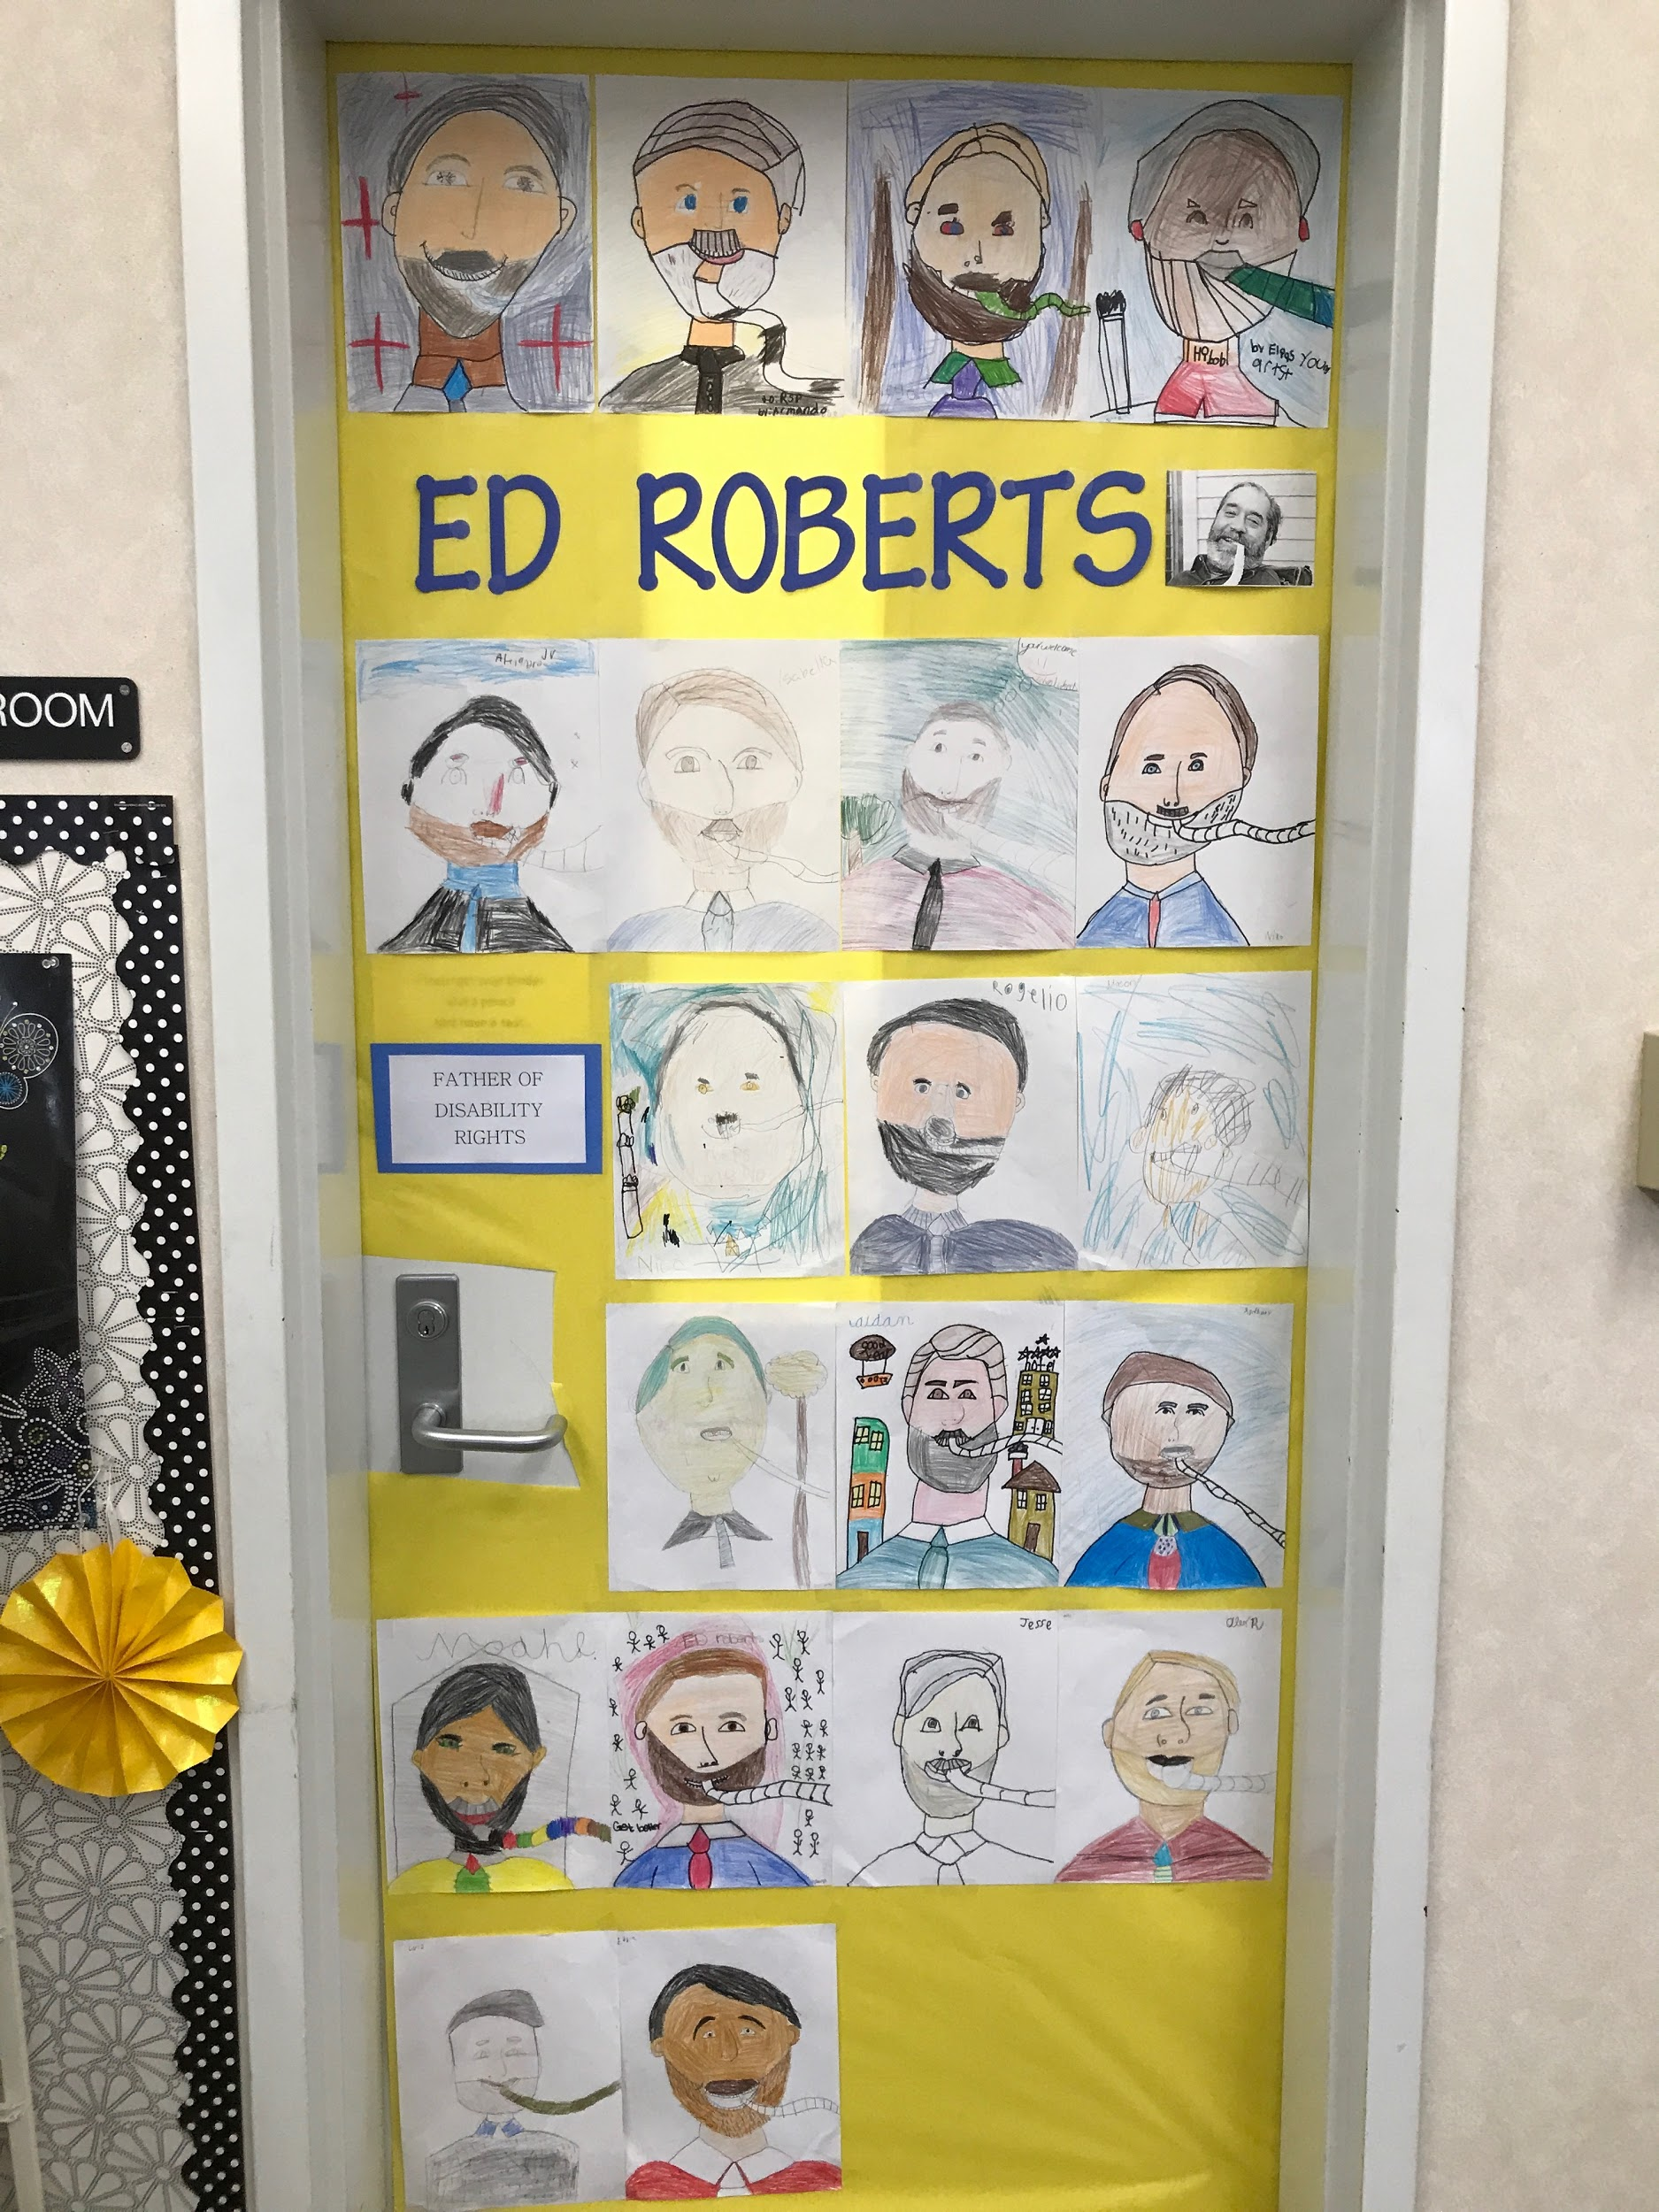
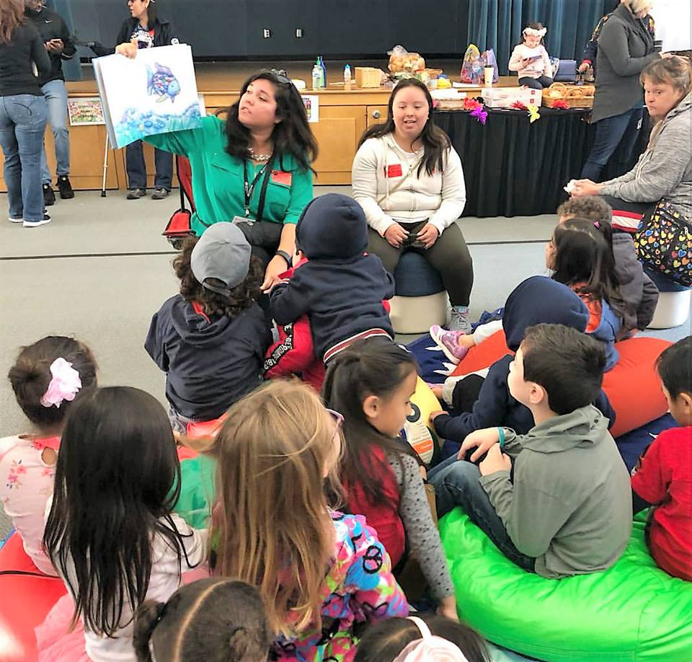
Ed Roberts classroom door by Diana Pastora Carson. CC0 1.0
Book Reading time by Diana Pastora Carson. CC0 1.0
@DianaPastoraCarson
Notes:
[INSTRUCTIONS - You can close up your presentation by watching this video and/or you can simply proceed to the photographs below]
Here is a video of what an annual Beyond Awareness event can look like. But it can also look very different.
Our goal is to make our event fit our school’s needs and culture while ensuring that the Disability Studies in Education Tenets and the Five Fundamentals for moving Beyond Awareness are adhered to, no matter what the structure looks like. The content will stay the same, but the structure will be uniquely ours. And we welcome your feedback and suggestions for how we can incorporate this here at our school.”
https://www.nbcsandiego.com/on-air/as-seen-on/Chula-Vista-Students-Learn-About-Life-With-Challenges_San-Diego-505538202.html
Video on 10 News with Joe Little

Slide 25
When we begin to understand our role in disabling others, we can begin to empower us all.
Diana Pastora Carson, M.Ed Diana@AbilityAwareness.com
@DianaPastoraCarson
Notes:
Thanks for letting us share this exciting possibility for our students and staff. And thanks in advance for your support. If you have any questions or want to participate on the Beyond Awareness committee, let me/us know!
To learn more about their journey, watch Diana’s TEDx Talk:
https://www.youtube.com/watch?reload=9&v=ruXB3lbiD3U

Slide 26
References cited
Barske, F. (2017, December 16). Self library education inside [digital image]. Retrieved from (here). CC BY 2.0
Carson, D. P. (n.d.). Beyond awareness poster. CC0 1.0
Carson, D. P. (n.d.). Children’s book on the table. CC0 1.0
Carson, D. P. (n.d.). Teacher books. CC0 1.0
Carson, D. P. (n.d.). Ed Roberts classroom door. CC0 1.0
Carson, D. P. (n.d.). Book Reading time. CC0 1.0
DMCA. (n.d.). Large group of people. [digital image]. Retrieved from (here). CC0 1.0
Kasinger, C. (n.d.). Disabled and here. [photograph]. Retrieved from (here). CC0
Openclipart. (2015, December 08). Hands of different color [digital image]. Retrieved from (here). CC0 1.0
Max Pixel. (n.d.). Streamers Decoration Confetti Party Celebration [digital image]. Retrieved from (here). CC0
@DianaPastoraCarson

