Slide 1
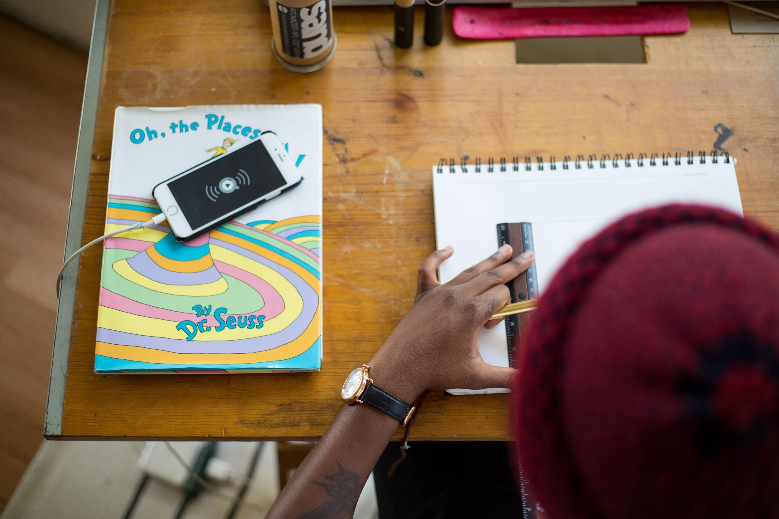
How We View Disability and
Why It Matters at School
Drawing artist and Dr. Suess by Tamarcus Brown. CC0
Created by Dr. Suzanne Stolz as part of the Leaders for Inclusion Project at the University of San Diego and generously funded by the Johnson Family Foundation.
August 2019
@SuzanneStolz
Notes:
This presentation focuses on how we view disability and why it matters at school.
Seldom do teachers have the opportunity:
To think deeply about the way they have come to think about disability
To examine their assumptions
and reflect on their experiences with disability and how that impacts the way they teach
Having time and space for conversation about disability can positively impact our practice and the learning environments we create.

Slide 2
Learning Objectives
Write your own definition of disability, reflect on your own conceptions.
Compare the medical model and the social model of disability.
Use the social model to define disability, placing it in the context of valued diversity.
@SuzanneStolz
Notes:
The objectives set for this workshop focus on considering how we view disability.
You can expect to write your own definition, compare two different ways of thinking about disability (the medical model and the social model), and finally use the social model to refine your definition.

Slide 3
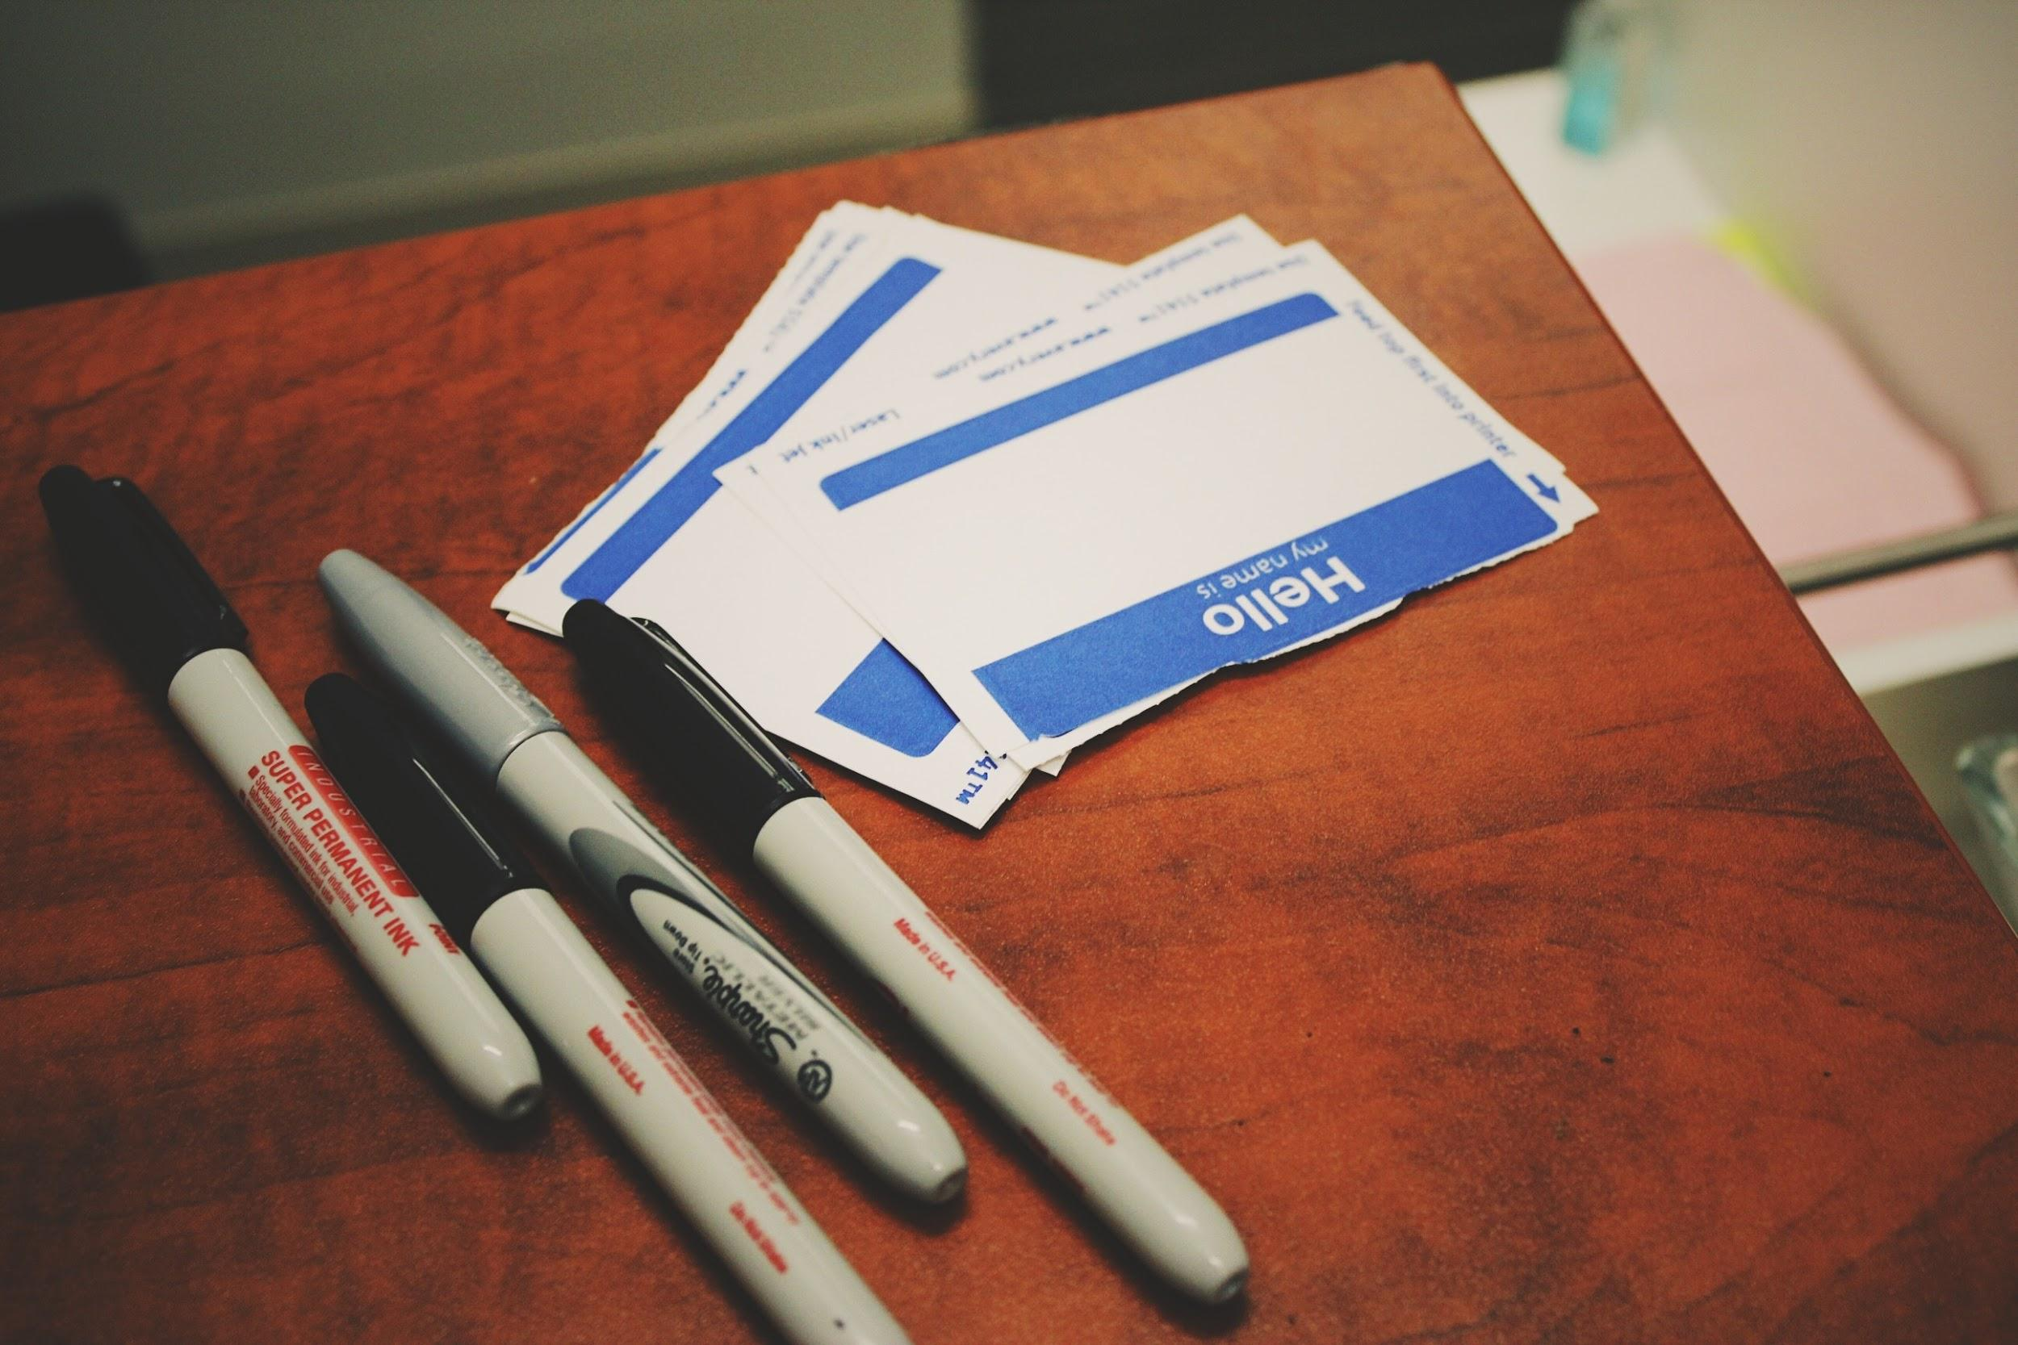
Introductions: Who is in the room?
Share with us the following:
Your Name
Your Interests
Disability is…
@SuzanneStolz
Name tag by Jon Tyson. CC0
Notes:
[INSTRUCTION - Give everyone an index card.]
On the index card, please write your own definition of disability. You will have an opportunity to share your definition in small groups.
In asking folks to write a definition, you may want to put them at ease by telling them:
We all have different experience with and knowledge of disability. Some of us have firsthand knowledge. Others of us have learned from family members, friends, and students. So, we won’t be surprised to see a wide variety of ways to define disability.
[INSTRUCTION - After everyone writes their definition of disability, in small groups, note that each participant will have two minutes to share among their peers: their name, their interests, and their definition of disability.]
[INSTRUCTIONS - Thank participants for sharing and for being willing to share their definitions of disability.]

Slide 4
Disability Studies in Education Tenets
To engage in research, policy, and action that
contextualize disability within political and social
privilege the interest, agendas, and voices of people labeled with disability/disabled people
promote social justice, equitable and inclusive educational opportunities, and full and meaningful access to all aspects of society for people labeled with disability/disabled people
assume competence and reject deficit models of disability
(American Educational Research Association, 2019)
@SuzanneStolz
Notes:
The series of resources and workshops created by the Leaders for Inclusion project, from which this is borrowed, is based on the tenets of Disability Studies in Education.
This field encourages educators to engage in research, policy, and action that
contextualize disability within political and social
privilege the interest, agendas, and voices of people labeled with disability/disabled people
promote social justice, equitable and inclusive educational opportunities, and full and meaningful access to all aspects of society for people labeled with disability/disabled people
assume competence and reject deficit models of disability
[INSTRUCTION - After reading the four bullet points of the Disability Studies in Education, prompt participants to share]
After hearing/reading these four bullet points, what questions or comments come to mind?
On this slide, two phrases are highlighted to show which tenets are specifically addressed in this presentation. Through your participation, you can witness contextualizing disability with political and social realms and a rejection of deficit models of disability.

Slide 5
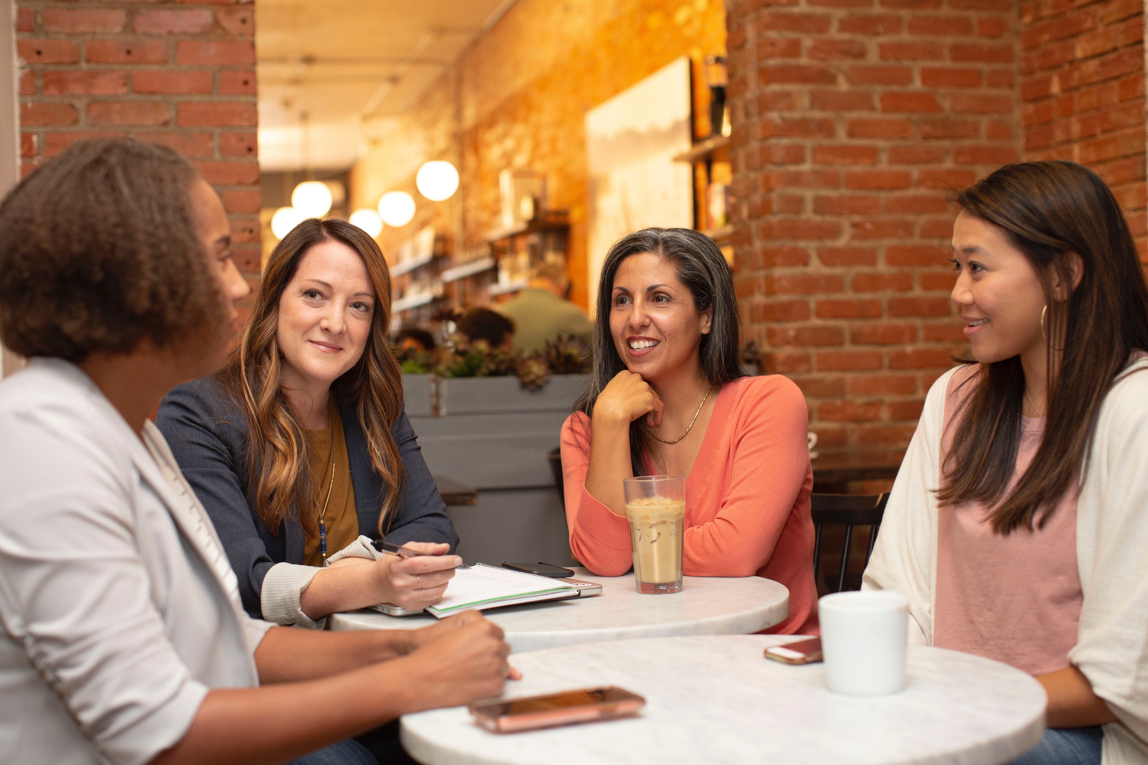
How do we view disability?
Think Pair Share:
Your earliest memory related to disability
Your most recent memory related to disability
Four women working in a business meeting by LinkedIn Sales Navigator. CC0
@SuzanneStolz
Notes:
The way we view disability is impacted by the experiences and interactions we have had.
We will do an think pair share activity where I will ask each of you to partner up, and listen to each others’ earliest and most recent memory related to disability.
Before we proceed, I want to share an early memory related to disability.
[NOTE - By doing so, you, the facilitator, model what are the expectations for this activity]
[EXAMPLE]
[I, Suzanne, remember being a small child who did not walk. My father often picked me up when we were going somewhere, saying “Come on, Suz.” In these instances, my impairment brought me closer to my father and I very much felt valued as an important part of the family. I also remember another child telling me, “My mom said you are sick.” Although this was a simple way for a mother to explain disability to her child, I felt confused and misunderstood.]
Now, I am going to ask you to think in silence about your own experience with disability for a minute. Do you remember your first interaction with disability? Was it at home or school or in the community? And what recent experience have you had? Once everyone is ready, please find a partner and share an early and a recent memory.
[INSTRUCTIONS - After everyone has had a couple minutes to share, ask the whole group]
What did you notice about the memories that were shared?
How far back do these memories go? This may tell us there is some emotion tied to the memories if they have stayed with us a long time.
Did anyone have the same memory that their partner had?
[INSTRUCTIONS – Highlight the patterns and differences from the discussion and note how our experiences with disability have shaped how we think and interact with people]

Slide 6
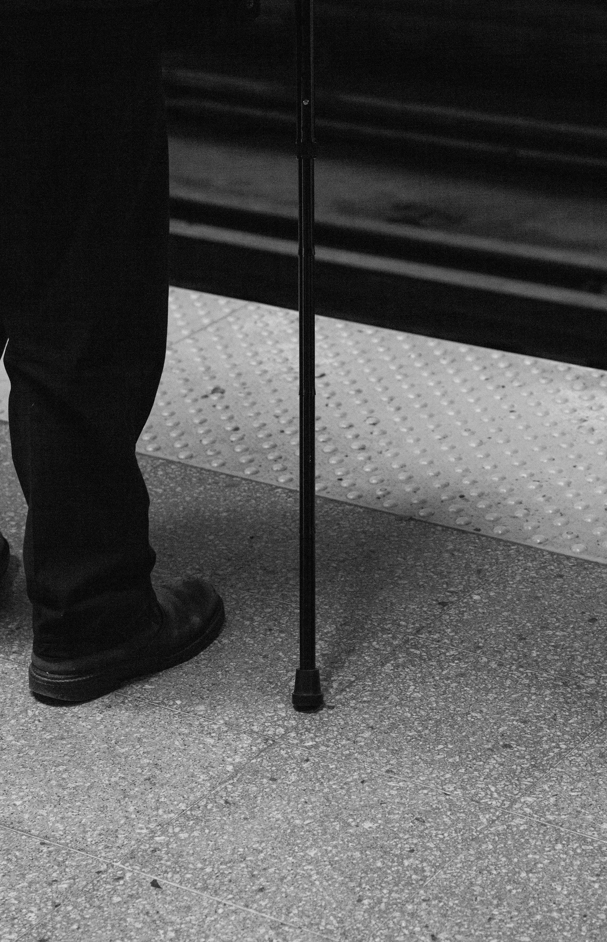
What else informs your thinking?
@SuzanneStolz
Man with cane by Charles Deluvio. CC0
Notes:
Aside from our own memories, we form ideas about disability from our engagement with many other sources. What other sources inform your thinking?
For example, the media informs our ideas. If there are few representations of disability on TV, that can give us ideas about how important disabled folks are or are not. If the representations we see are stereotypical, that may give us a very limited view of what disability means. If media depictions are thoughtful and nuanced, we may get insight we hadn’t considered before.
Policy informs our ideas. Do laws and policies support the inclusion of disabled folks? Does law and policy exclude? Do you notice this? How does it impact you? Do you know what the Americans with Disabilities Act (ADA) is? Passed in 1990, this law has moved us to expect access in public spaces, on transportation, and in employment. How might it change the way we think about disability?
[INSTRUCTIONS - Ask participants for ideas or examples of other sources that informs one’s thinking. List out different sources.]
Are there sources other than media and policy that have informed you about disability? Did you learn about it in school?”
[INSTRUCTIONS – Acknowledge the responses and thank participants for sharing their ideas.]

Slide 7
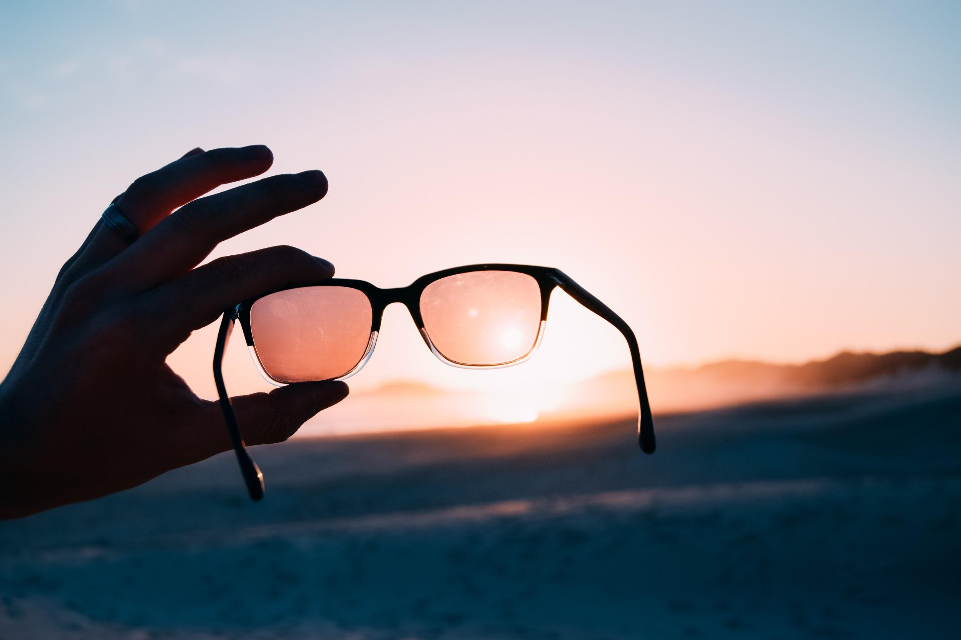
The root of disability depend on the lens you use...
Tinting the sunset by Joshua Forbes. CC0
@SuzanneStolz
Notes:
While many variables impact our conceptions of disability, there are different models we use as a basis of our conception.
Have you ever marveled at how different the world looks when you look through sunglasses or perhaps when you put on your own eyeglasses?
How might a different lens change the way we view disability?
[INSTRUCTIONS - Ask participants if they have any ideas or examples of a different lens.]
We are going to look through two different lens together.
The medical model and the social model are two different ways of viewing disability.
As we look at each of these individually, look for the root of disability.
You might also think about the way you’ve learned to think about disability.
Ask yourself, “Have either of these models been part of my thinking?”

Slide 8
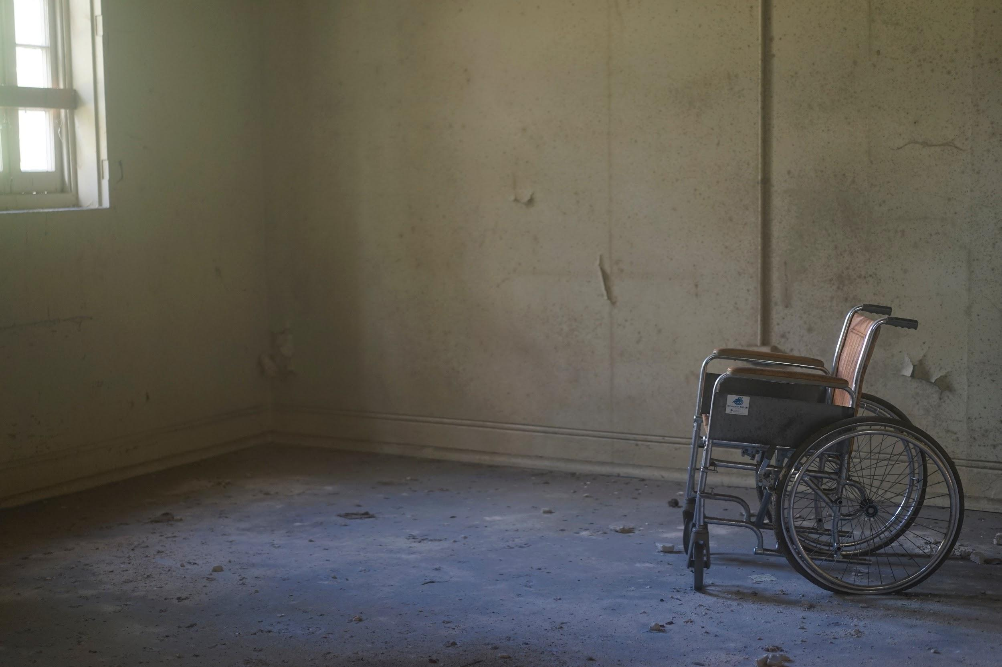
Medical Model of Disability
Problem that needs to be fixed or cured
Defect, deformity, tragedy
Individual issue
Student = Patient
Social policies: institutions, segregation, charity
(Shapiro, 2003)
Shot of an abandoned Victorian building which used to be part of a mental institution by Doug Maloney. CC0
@SuzanneStolz
Notes:
The medical model has historically been the most prevalent way through which people have conceptualized disability.
This model says disability is a defect or deformity, often a personal tragedy that needs to be fixed or cured.
[INSTRUCTION – share a personal example (whether it is yours or an observation) to help the participants grasp the medical model.]
The medical model also has deemed disability as an individual issue, as something that often evokes pity from others.
In schools, and particularly within special education, this model moves educators to view students as patients instead of learners.
Social policies derived from the medical model include the use of institutions, segregation, and charity. Within the past century, many disabled folks, children and adults, were taken out of families and communities to live in institutions. Rather than offering support within communities, policies forced many to live and die incarcerated.
How do we still see this legacy today? Even outside of institutions, we can find segregation of disabled folks: in schools, in housing, in transportation.
While many people can easily recognize the harm in warehousing people in institutions and in segregation, they often do not see the harm in charity. Charity though often involves feeling pity and assuming that recipients of charity are less valuable.
[INSTRUCTIONS - Ask participants how they are feeling about this model]
Because the medical model has been so prevalent, it’s not unusual that we have some part of it in our own thinking. Often, this is what we have learned.
[INSTRUCTIONS - Ask participants - If we see problems with what we have learned, can we unlearn? If so, how?]
[After the discussion, thank participants for sharing.]
Usually, we need to find a better model. So, let’s look at another model…

Slide 9
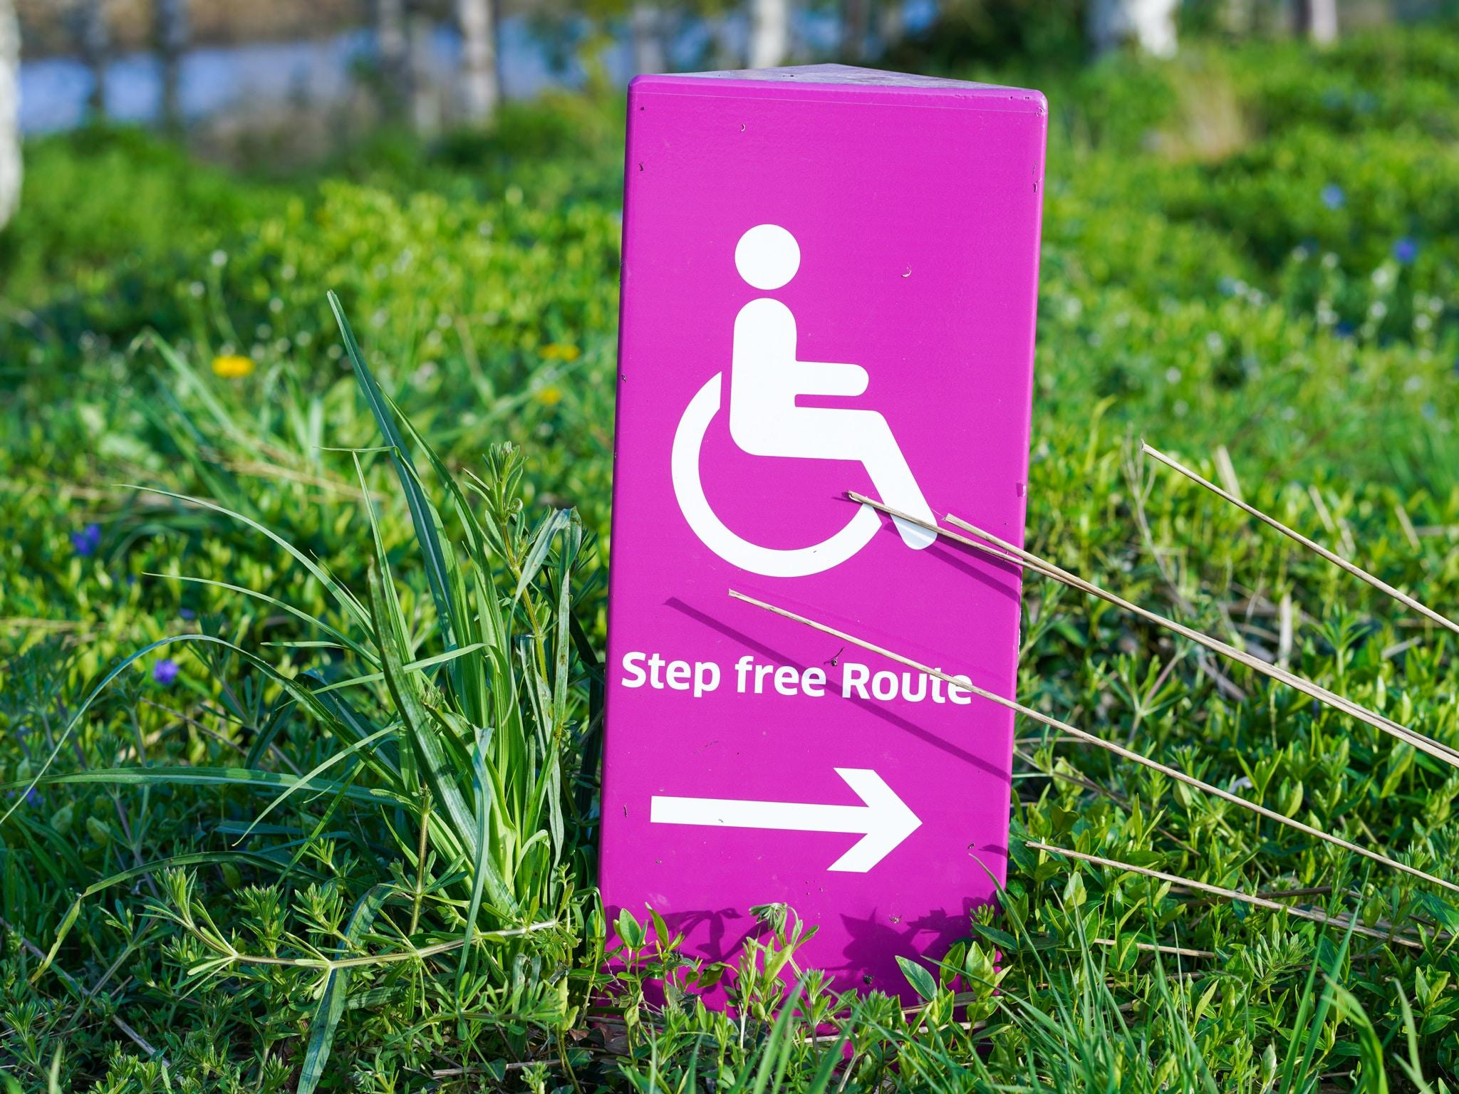
Social Model of Disability
Disability is diversity; differences are natural.
Considerations of barriers
Social issue
People demanding control of their lives and full access to mainstream society
Provides perspective on autonomy, wholeness, independence, dependence, health, physical appearance, aesthetics, community, and the notion of perfection
                (Shapiro, 2003)
Step free route by Yomex Owo. CC0
@SuzanneStolz
Notes:
The social model is quite different from the medical model.
With this model, differences are natural and places disability alongside other valued parts of diversity.
This model highlights barriers as the root of disability and considers the removal of barriers a social responsibility.
For example, a true story: A little girl arrived at her neighborhood school, the first wheelchair using student to attend the school. Having been taught by her parents that disability is natural, she looked at the playground and said, “This playground is not accessible.”
This girl used the word not accessible, which is significant as her statement locates the problem within the environment, not within her own body. She did not say, “I can’t play on this playground.”
Imagine how different a child would feel when they do not see themselves as a problem!
This model is about people “demanding control of their lives and full access to mainstream society.”
It provides perspective on a range of ideas. What is wholeness? What is community? What is perfection?
[INSTRUCTIONS – ask the participants - Does anything from this model seem apparent in the way you think about disability? If not, is there anything here you might like to adopt?]
[After the discussion, thank participants for sharing.]
Let’s look a little further at the social model and its attention to barriers...

Slide 10

What is ableism?
Have you witnessed it?
Chainlink fence by Kenny Luo. CC0
@SuzanneStolz
Notes:
Using the social model of disability requires some understanding of what ableism is and how to identify it.
However, few of us have had formal opportunity to learn about it.
[INSTRUCTIONS – ask participants - Do you know what ableism is? Have you ever heard the word? If not, can you guess what it means?”]
[If participants know the word, ask them to tell the group what it means. If not, tell them, “Ableism is discrimination based on disability. Like racism, classism, and sexism, it comes in many forms.”]
[INSTRUCTIONS – share a personal example of learning the word - ableism (whether it is yours or an observation) to help facilitate the conversation.]
[“For example, Suzanne did not learn the word until I started graduate school. As a student experiencing disability, she didn’t hear the word in elementary school, high school, or in 4 years of college. Even though she didn’t know the word, she had experienced ableism many, many times as a child, teen, and young adult. Do you think it might have been helpful for her to know the word?”]
Now that we’ve established what it is, let’s think about times we’ve witnessed it. What does it look like?
[INSTRUCTION - Allow participants to pair share or ask for volunteers to share out what they have witnessed.]

Slide 11
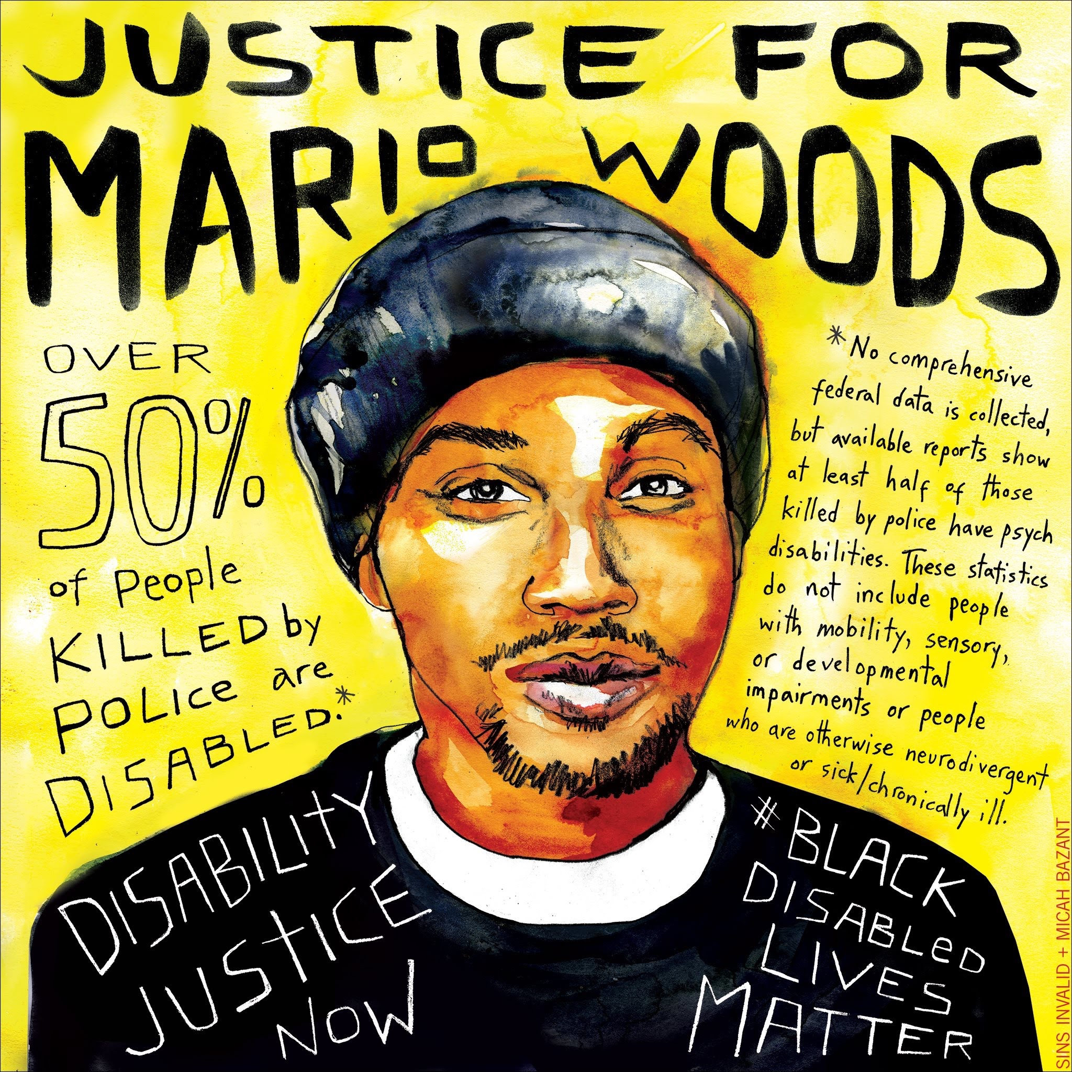
More from the Social Model
Ableism
  Prejudice, Stereotypes,
  Discrimination
Acknowledgement of…
  Unequal recognition under
  the law
  Unequal education
  Unequal employment
  Unequal freedom of movement
  Lack of transportation
Double discrimination
(or intersectionality)
(Shapiro, 2003)
Justice for Mario Woods by Clarion Mural Project. Reprinted with permission.
@SuzanneStolz
Notes:
Having a sense of what ableism is and what it looks look, we are considering barriers that individuals with disabilities face.
The social model helps us remember that those barriers are often social barriers - in the environment, in policy, and in interactions within communities.
Members of other oppressed groups can certainly relate to experience of unequal access.
Folks with disabilities experience unequal recognition under the law. The image on this slide, created by Micah Bazant, shows a young black man wearing a black shirt with a white collar and a black beanie in the center of the image with a yellow backdrop. On top of the image, there is black text that says “Justice for Mario Woods.” On the left side of the image, the black text says, “Over 50% of people killed by police are disabled. Disability Justice Now.” On the right side of the image, the black text says, “No comprehensive federal data is collected, but available reports shows at least half of those killed by police have psych disabilities. These statistics do not include people with mobility, sensory, or developmental impairments or people who are otherwise neurodivergent or sick/chronically ill. #Black Disabled Lives Matter.” Mario Woods was a 26-year-old killed by the police in 2015 when he didn’t drop the knife he was holding, and in the end, police were not charged with the killing.
Aside from that grave injustice, students with disabilities experience unequal education, sometimes segregated and sometimes underserved or neglected in mainstream settings.
Many are denied employment opportunities or receive subminimum wage for their labor.
Many experience unequal freedom of movement, often denied opportunities to move, live, and work where they choose.
Many also find a lack of transportation: public transportation, accessible transportation, affordable transportation. One example, newer companies like Uber and Lyft have provided a new mode of transportation with very little provision for wheelchair access.
These inequalities related to ableism are consequential. It’s important to acknowledge that many folks experience double or multiple forms of discrimination.
[INSTRUCTION - Ask participants, “What do you already know about this?” Allow them to discuss in pair share or as a group.]
Some of us experience ableism and racism, ableism and sexism, etc. The social model moves us to not only acknowledge these forms of oppression as barriers but. also to work to remove them.
[Micah Bazant gave permission to use this image.]
Bazant, M. & Sins Invalid (December 2015). Justice for Mario Woods. [Digital Image]. https://www.micahbazant.com/mario-woods . Clarion Mural Project.

Slide 12
Which model of disability did my memory rely on?
Think Pair Share: Remember at the beginning - early memory and one recent memories of disability.
Which model or models of disability did you use?
@SuzanneStolz
Notes:
Now, we are going to return to the memories you shared.
As you consider those memories, can you identify which model of disability (medical or social) you relied on at the time?
[INSTRUCTIONS – Give the participants 4-5 minutes to share in pairs. When the discussion is over thank them, and ask for feedback about what they noticed.]
[Summarize the participants shared]
It’s certainly okay to acknowledge our use of the medical model because we know our conceptions are continually changing as we gain new information.
The point of this exercise is to practice our skill in identifying models of disability. If we haven’t yet used the social model, we might be able to start imagining how it might change our thinking and our interactions. Practice being a non-judgmental listener as you pair-share again.
It may be important to acknowledge that people with disabilities often rely on assistance from medical professionals. A rejection of the medical model does not mean we need to discount the importance of the medical field. Rather, it is rejecting the notion that disability can be understood solely with medical terms.

Slide 13
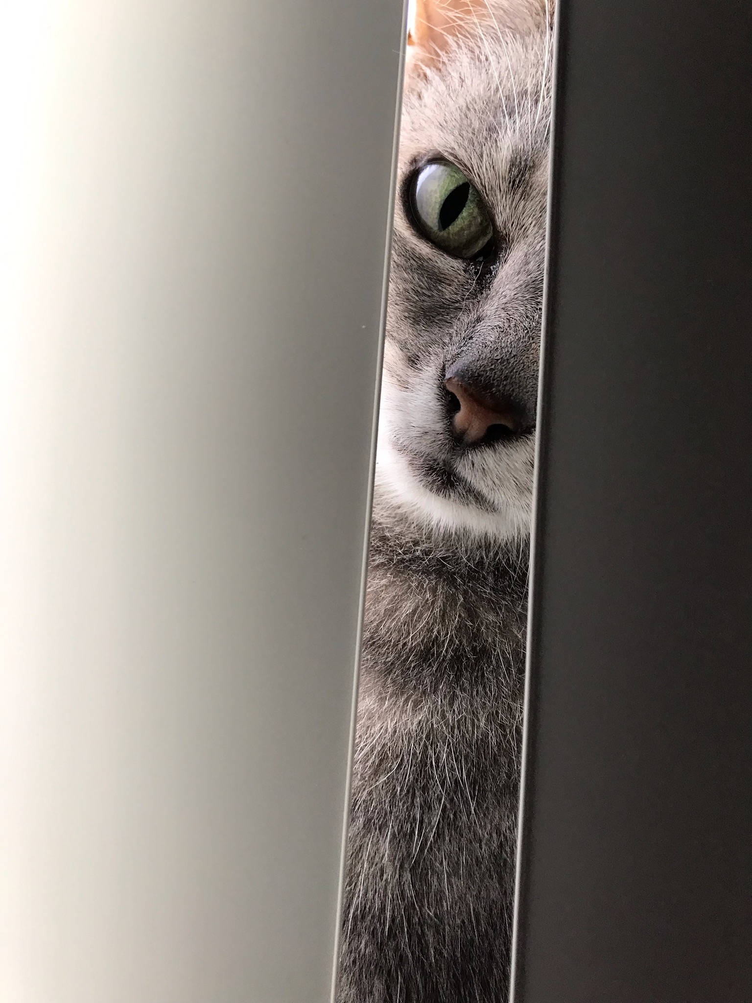
Why does your model of disability matter?
Cat peeking through blinds by Ed Philippi. Reprinted with permission.
@SuzanneStolz
Notes:
The way we think about disability matters.
Why?
What difference might it make in the world?
In the lives of your students?
Within your own families?
[INSTRUCTIONS - Ask for some ideas from the participants. Validate or redirect as needed.]
Philippi, E. (2019). Cat peeking through blinds. [Unpublished personal photo].

Slide 14
Why does your model of disability matter in the lives of young people?
Youth's Conception of Disability
Self-Expectations and Goals
View of Self
(Stolz, 2010)
@SuzanneStolz
Notes:
A young person’s understanding of disability impacts their view of themselves and the expectations and goals they have for their lives.
If they view disability as a deficit, how would this impact how they see themselves?
Could that change if they viewed disability as a natural part of human diversity?

Slide 15
Influences on Young People’s Ideas
Media Depictions
Peer Beliefs
Parents Beliefs
Medical Professionals
Teacher Practices
Social Policies and Practices
Disability Community
(Stolz, 2010)
@SuzanneStolz
Notes:
A number of things can influence young people’s conception of disability. You might be relieved to know it’s not just teacher practice!
Media depictions teach young people about gender roles, race relations, and disability too. How do they see themselves portrayed on TV, in movies, and in books? Are those positive or negative representations?
If we look at the next few bullets, we probably see influences we often consider. Certainly, parents’ and peers’ beliefs make an impact. For those who experience disability, medical professionals provide advice, sometimes helpful, sometimes misguided. Teacher practices play a role, encouraging growth or limiting opportunity.
Social policies and practices that are inclusive or exclusive make a difference. Young people growing up after the passage of the Americans with Disabilities Act interact differently with the world than those from earlier generations.
A finally we see disability community. What is disability community? People define this in a variety of ways. For our purposes today, let’s think about it as the folks with firsthand disability experience that young people see or interact with in their communities. Are they sharing wisdom? Are they leading lives that provide examples young people want to follow? Do young people even have access to them?

Slide 16
Return to Your Own Definition
“Disability is…”
Rewrite your definition using the social model and convey disability’s place as a valued part of diversity.
@SuzanneStolz
Notes:
When you introduced yourself at the beginning of our time together, you completed the sentence: “Disability is…”
Now that you’ve had an opportunity to compare the medical model and the social model, rewrite your definition using the social model.
If you first definition already used the social model, consider ways to clarify your definition.
When everyone is done, share your new definition with two or three other people.

Slide 17
Reflection
How can teachers promote positive conceptions of disability among students and in the community?
What can teachers do minimize the harmful effects of ableism within schools?
@SuzanneStolz
Notes:
Thank you to everyone who shared their definitions, especially to those of you who say a marked change in your new version.
As we wrap up our time together, let’s imagine together how we might apply this learning as we work with students and families.
How can teachers promote positive conceptions of disability among students and in the community?
How will we respond to negative or unfair depictions? How will we think interact differently with students?
And what can teachers do to minimize the effects of ableism in schools? Do we call it out? Do we teach students to recognize it?
[INSTRUCTION - invite participants to share ideas with the whole group. Jot down a list of their ideas on a chalkboard or poster. ]

Slide 18
Summary
As supportive teachers, we can:
contextualize disability within political and social
assume competence and reject deficit models of disability
and consider ways to confront ableism
@SuzanneStolz
Notes:
Our work today focused on how we conceptualize disability.
We know disability experience extends well beyond medical conceptions and impairments. Political, social, and cultural environments shape the experience and can erect barriers or offer access. Our acknowledgement of this helps us build better understanding and better relationships with students and families.
The medical model of disability is a deficit model. Assuming that one’s experience resides solely within the body is damaging.
In teaching, it is crucial to assume competence of all students and reject deficit models.
As we move forward, I encourage everyone to be conscious of your ever-evolving conception of disability.
Consider the sources that are informing you and consider the impact your thinking has on your actions and interactions.
[INSTRUCTION - Thank everyone for their time and participation.]

Slide 19
Recommended Readings
Baglieri, S. (2017). Disability studies and the inclusive classroom: Critical practices for creating least restrictive attitudes. Routledge.
Valle, J. W., & Connor, D. J. (2019). Rethinking disability: A disability studies approach to inclusive practices. Routledge.
@SuzanneStolz

Slide 20
References
Bazant, M. & Sins Invalid (December 2015). Justice for Mario Woods. [Digital image]. Retrived from https://www.micahbazant.com/mario-woods . Clarion Mural Project. Reprinted with permission.
Brown, T. (September 1, 2016). Drawing artist and Dr. Suess [Digital image]. Retrieved from https://unsplash.com/photos/zuQDqLFavI4. CC0.
Deluvio, C. (November 18, 2018). Man with cane. [Digital image]. Retrived from https://unsplash.com/photos/CDJuKaNJHFA. CC0.
Forbes, J. (February 8, 2018). Tinting the sunset. [Digital image]. Retrived from https://unsplash.com/photos/_3Z9kVNQusU. CC0.
LinkedIn Sales Navigator. (May 28, 2020). Four women working in a business meeting in a cafe coffee show. [Digital image] Retrived from https://unsplash.com/photos/IjkIOe-2fF4. CC0.
Luo, K. (March 4, 2018). Chainlink fence. [Digital image]. Retrived from https://unsplash.com/photos/VVpIN609QtY/info. CC0.
@SuzanneStolz

Slide 21
References (cont.)
Maloney, D. (December 3, 2017). Shot through the window of an abandoned Victorian building which used to be part of a mental institution. [Digital image]. Retrived from https://unsplash.com/photos/awxaj8YEwug. CC0.
Owo, Y. (April 17, 2018). Step free route. [Digital image]. Retrived from https://unsplash.com/photos/gRTzhQsiVG0/info. CC0.
Philippi, E. (2019). Cat peeking through blinds. [Unpublished personal photo]. Reprinted with permission.
Shapiro, A. (2003). Everybody belongs: Changing negative attitudes toward classmates with disabilities. Routledge.
Stolz, S. M. (2010). Disability trajectories: Disabled youths' identity development, negotiation of experience and expectation, and sense of agency during transition (Doctoral dissertation, UC San Diego).
Tyson, J. (January 19, 2018) Nametags. [Digital image]. Retrived from https://unsplash.com/photos/566CgCRSNCk. CC0.
@SuzanneStolz

